Slide 1
Current and Pending Activities of the Alabama Commission on Higher Education (ACHE)
2022 ALAIR Spring Conference
Jim Hood, Ph.D. | Deputy Director, Financial & Information Systems

Slide 3
Improved Social Media Presence
Enhanced Email Signatures

Slide 4
Improved social media presence

Slide 5
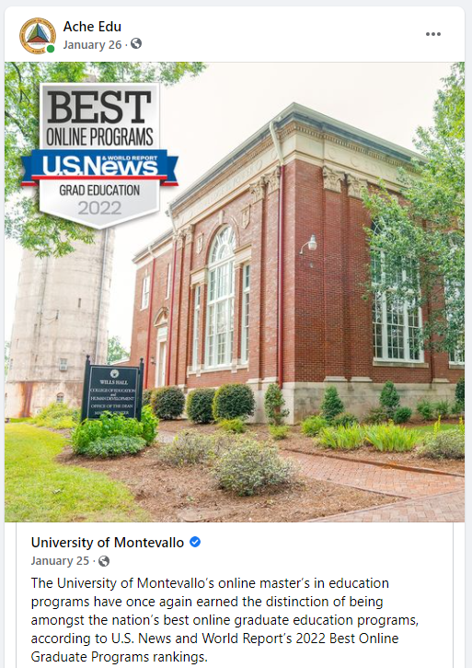
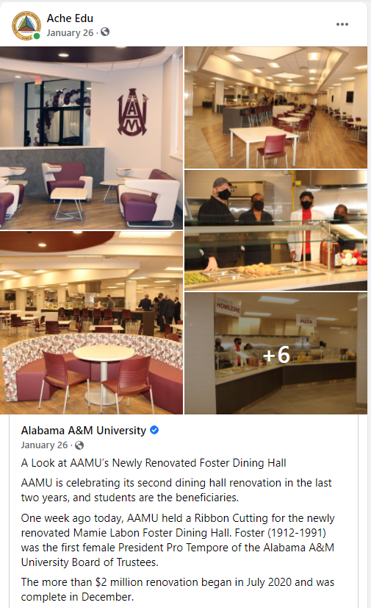
Using social media to promote Alabama’s colleges and universities

Slide 6
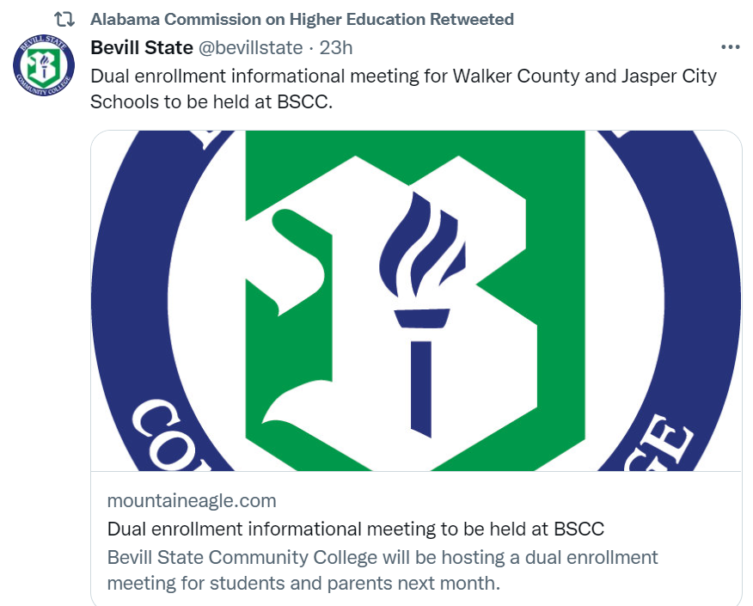
Using social media to promote Alabama’s colleges and universities

Slide 7
Using social media to promote higher education in Alabama

Slide 8
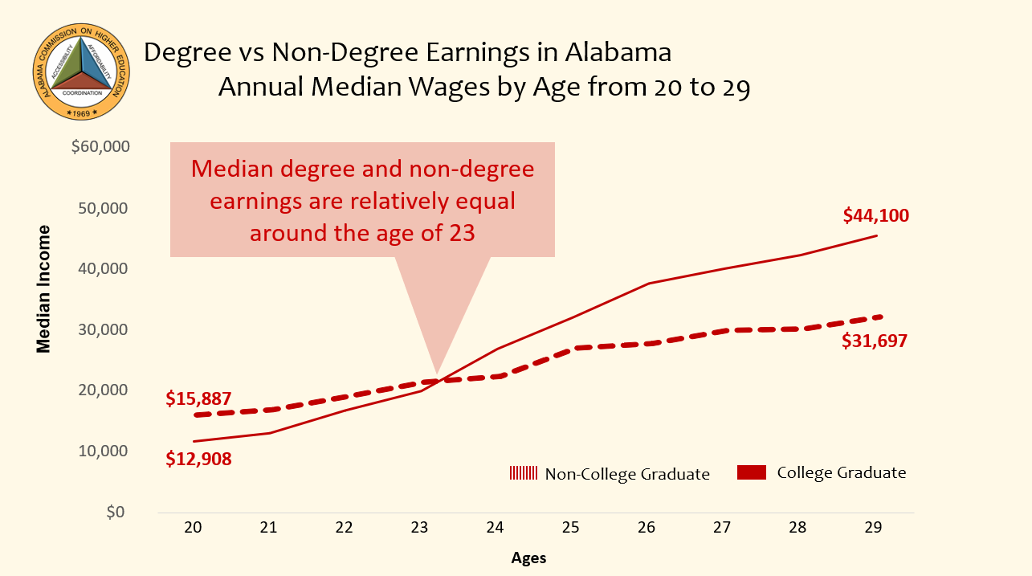
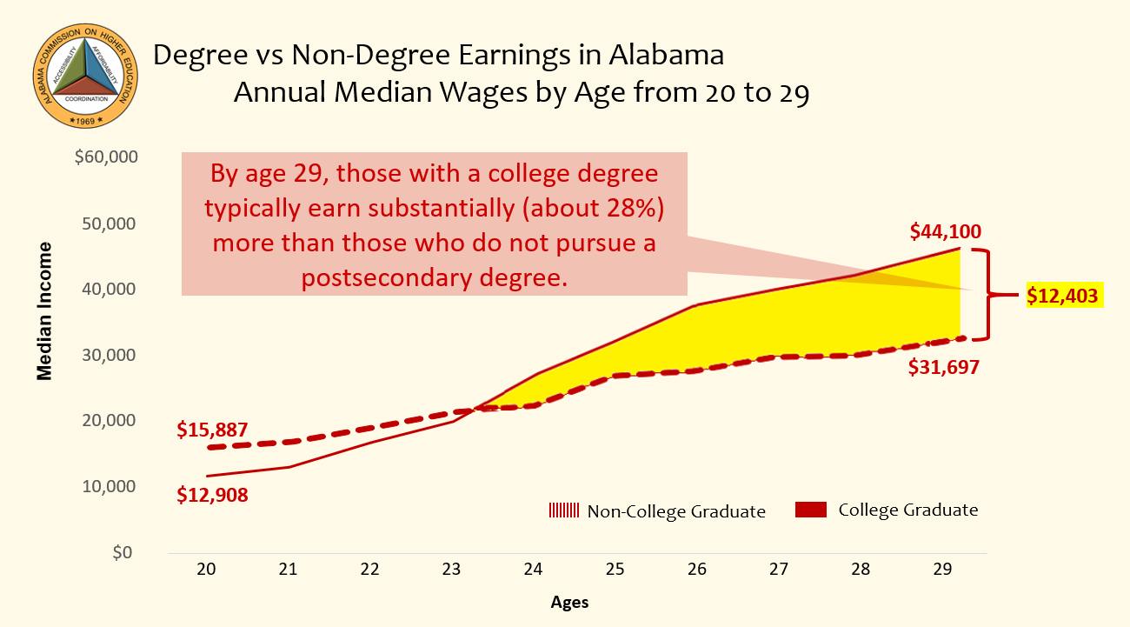
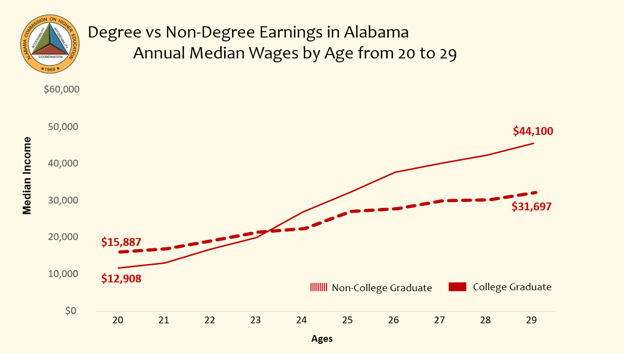
Using social media to promote higher education in Alabama

Slide 9
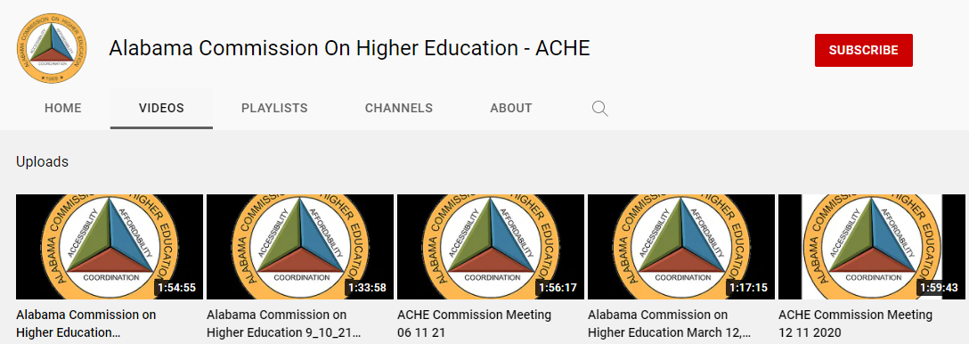
Using YouTube to make
ACHE more accessible

Slide 10
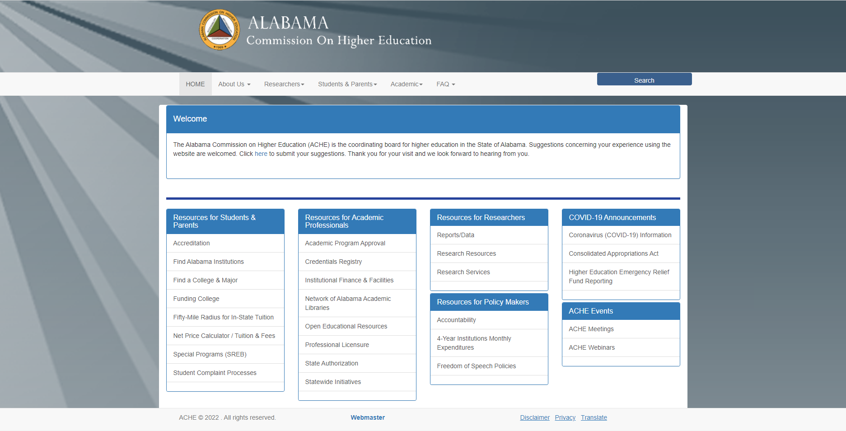
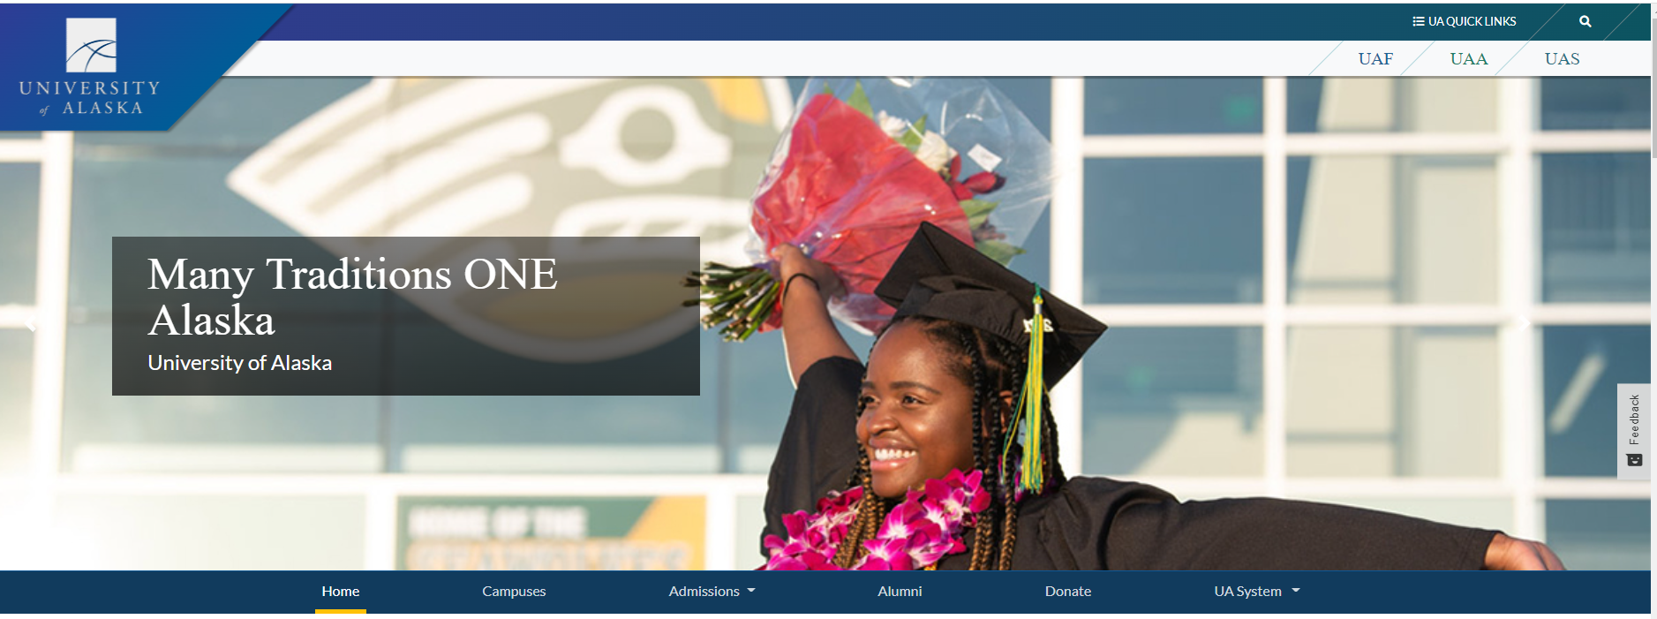
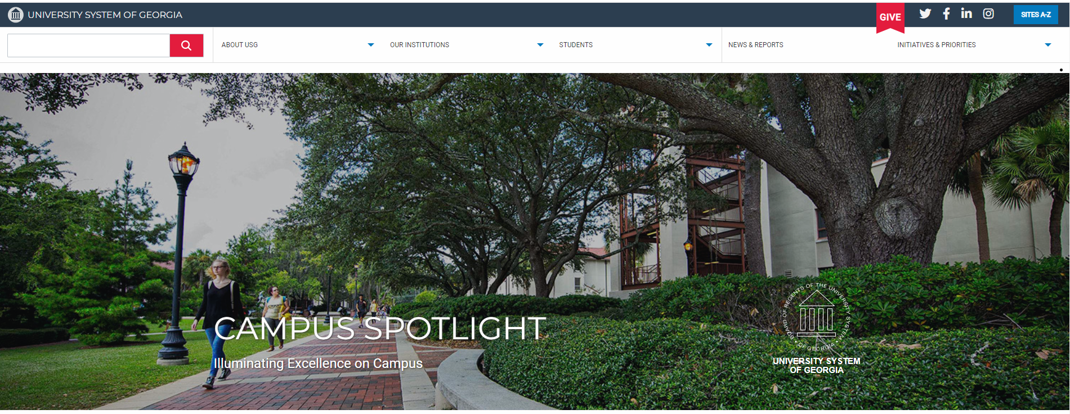
Updating Web Site

Slide 11
Developing New Data Portal (Power BI)
DATA SOURCES:
IPEDS
ACHE & IPEDS
ACHE

Slide 12
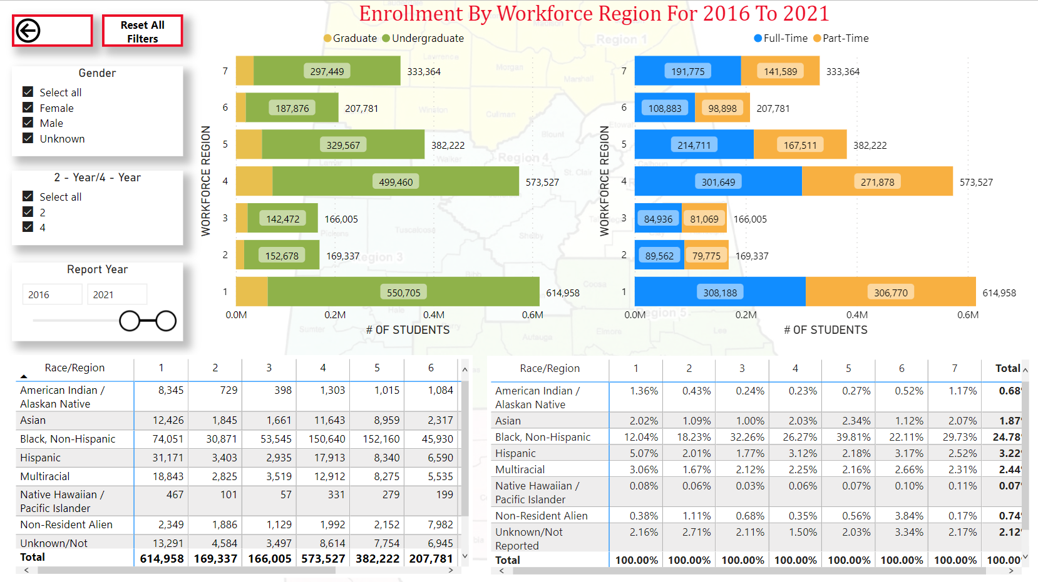
Developing New Data Portal (Power BI)

Slide 13
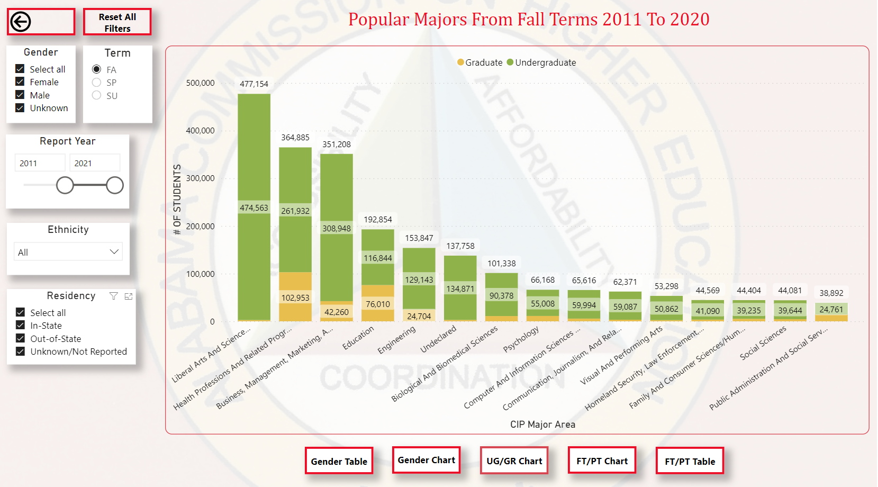
Developing New Data Portal (Power BI)

Slide 14
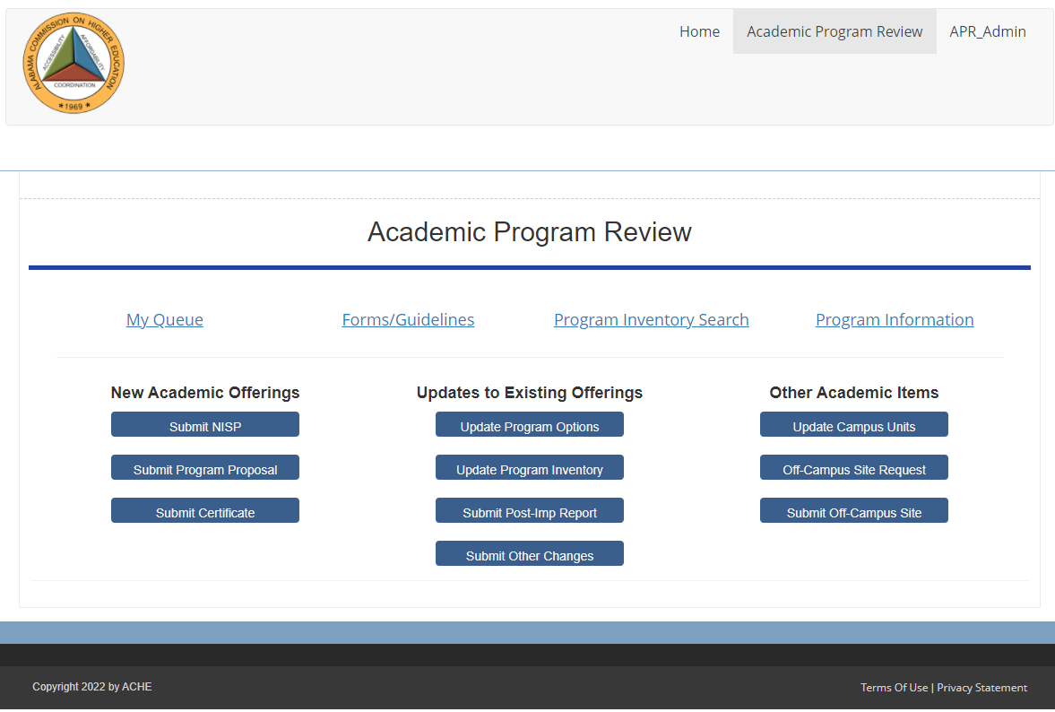
Using New Academic Program Portal
Academic Program Tool

Slide 15
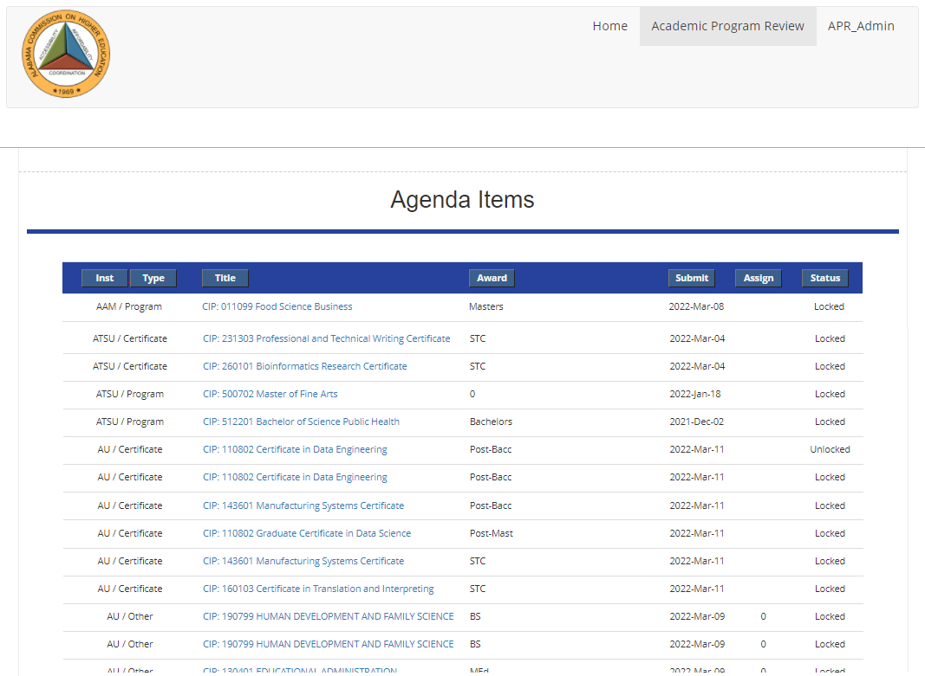
Using New Academic Program Portal
“My Queue” Agenda Items

Slide 16
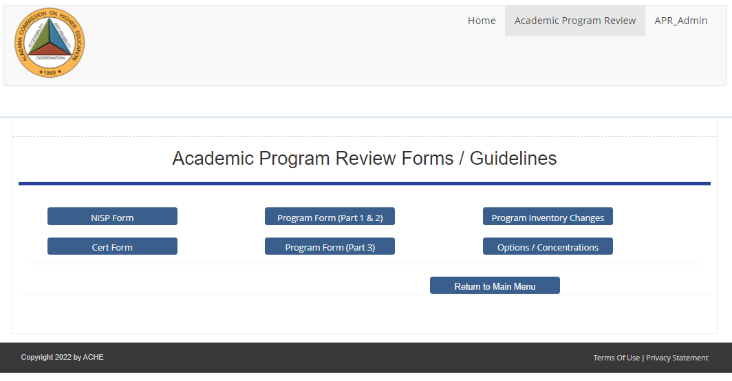
Using New Academic Program Portal
Forms and Guidelines

Slide 17
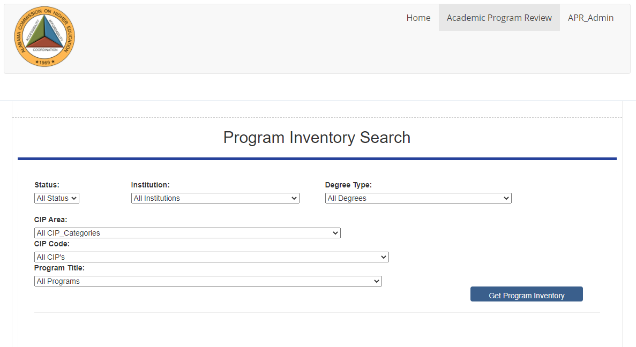
Using New Academic Program Portal
Program Inventory Search

Slide 18
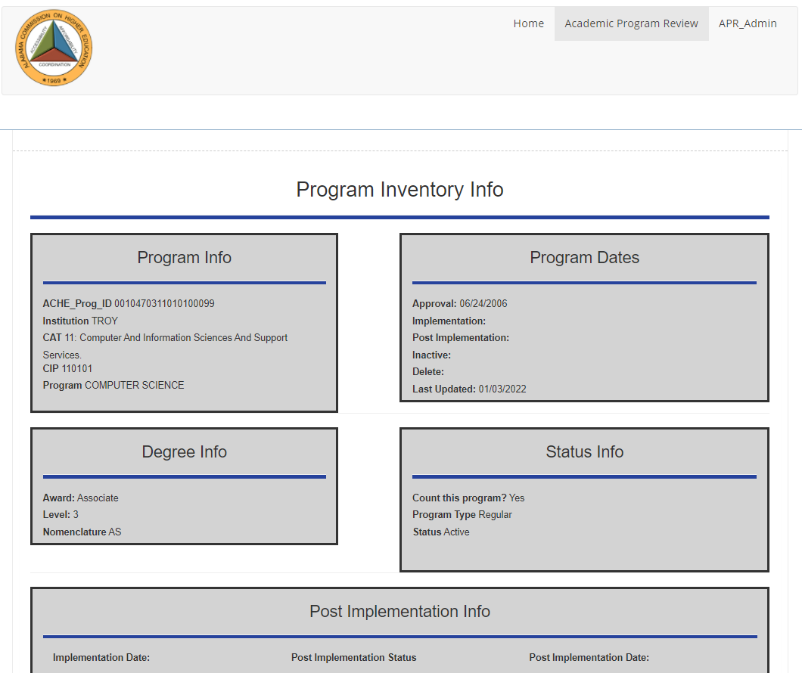
Using New Academic Program Portal
Program Inventory Information

Slide 19
Collaborating with ATLAS
Coordinated by OEWS in conjunction with Governor’s Office
Federal site visit yesterday and today
ACHE actively involved in development
Serving on all ATLAS committees:
Technical and Security
Research Review and Standards
Data Stewards
“Groundhog Day” approach to data requests

Slide 20
Collaborating with ATLAS
ACCS submits public community college data
ACHE submits public university data
ACHE recently provided data sharing agreements to universities along with plan for communicating future activity
First request: March 14
Governor’s Office
Educational Attainment

Slide 21
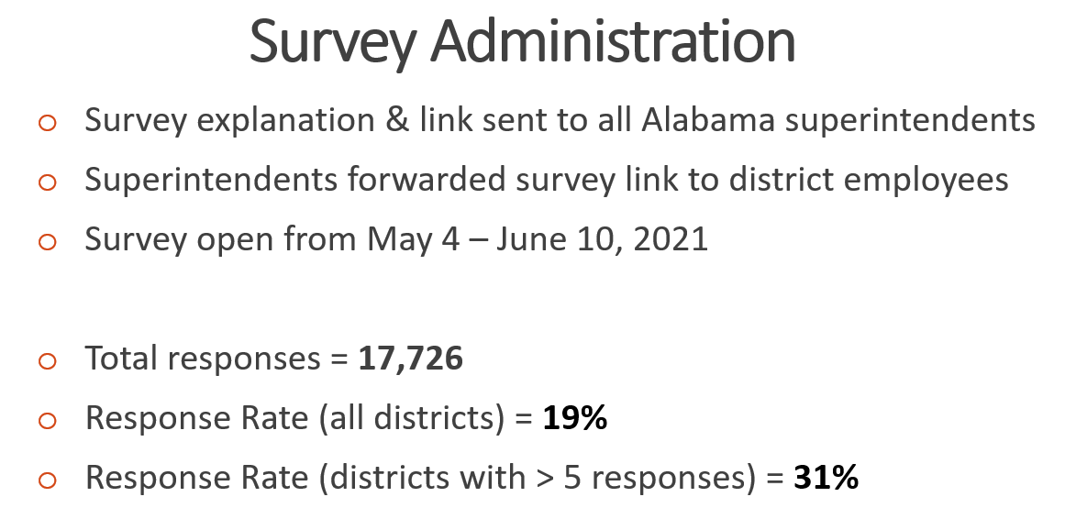
Studying the Teacher Pipeline

Slide 22
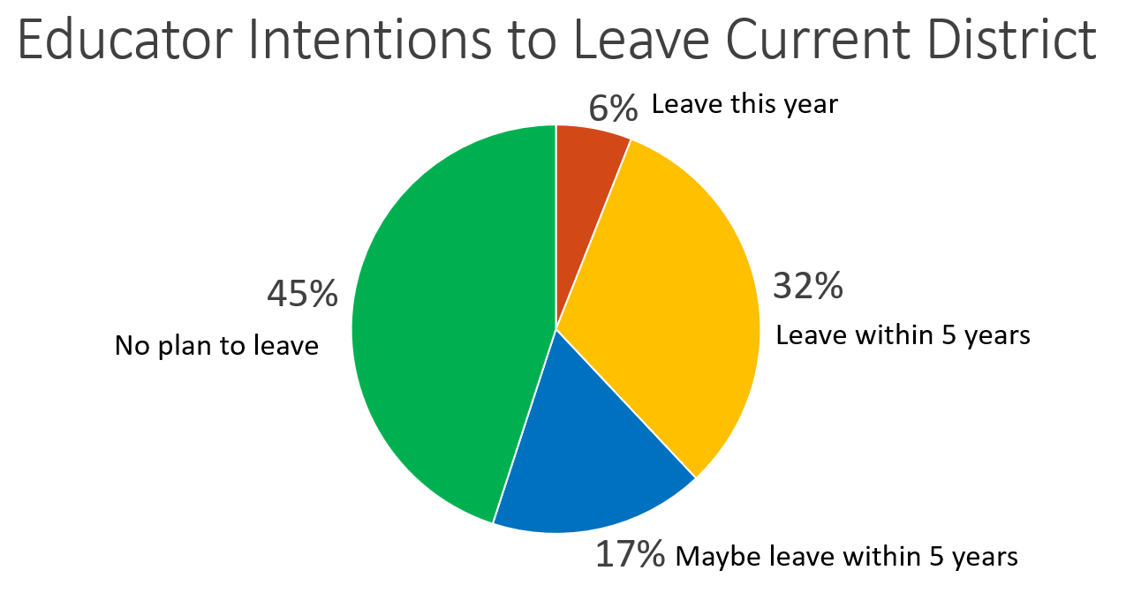
Studying the Teacher Pipeline
55% leaving or considering leaving

Slide 23
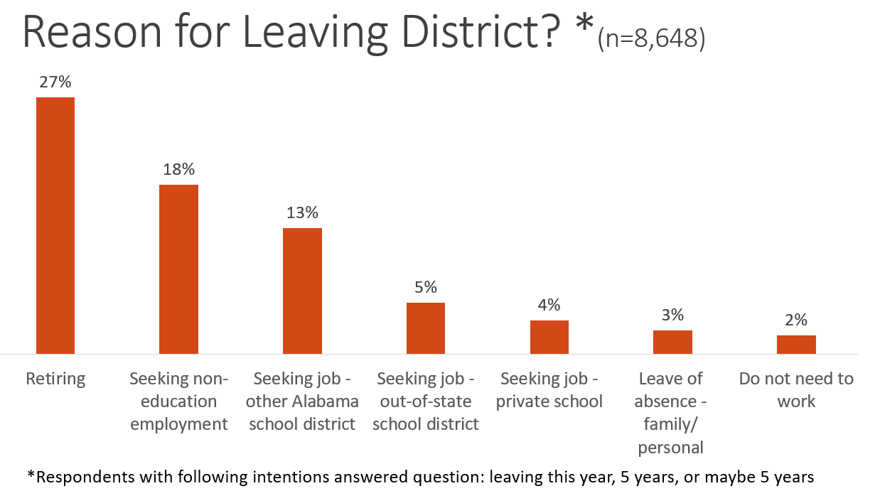
Studying the Teacher Pipeline
*55% leaving or considering leaving

Slide 24
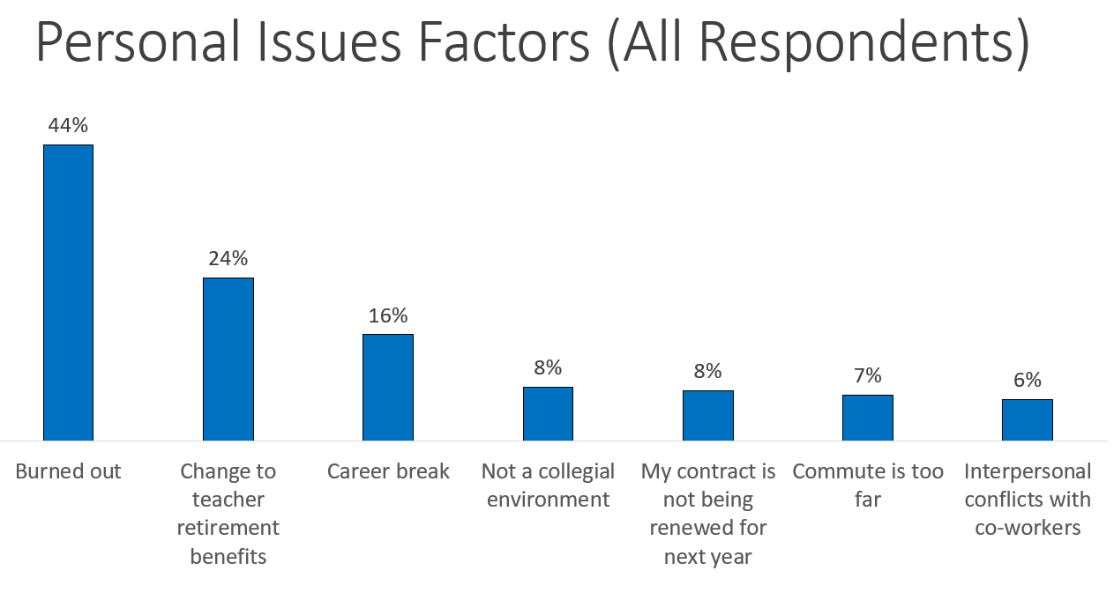
Studying the Teacher Pipeline

Slide 25
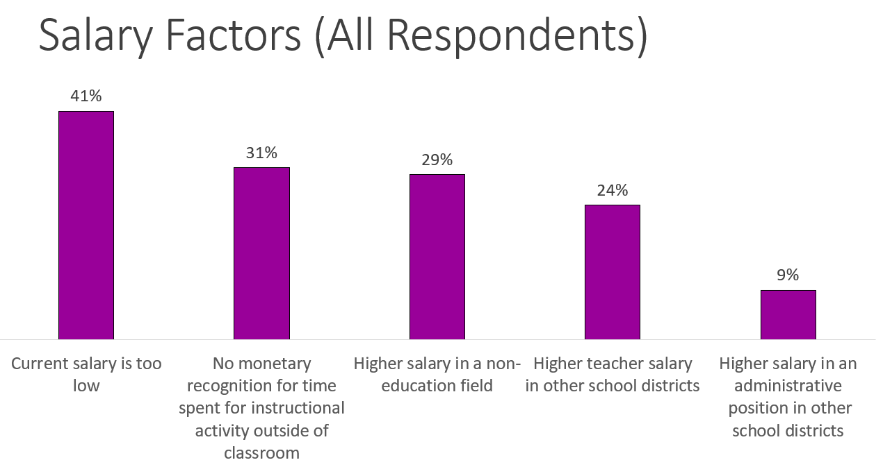
Studying the Teacher Pipeline

Slide 26
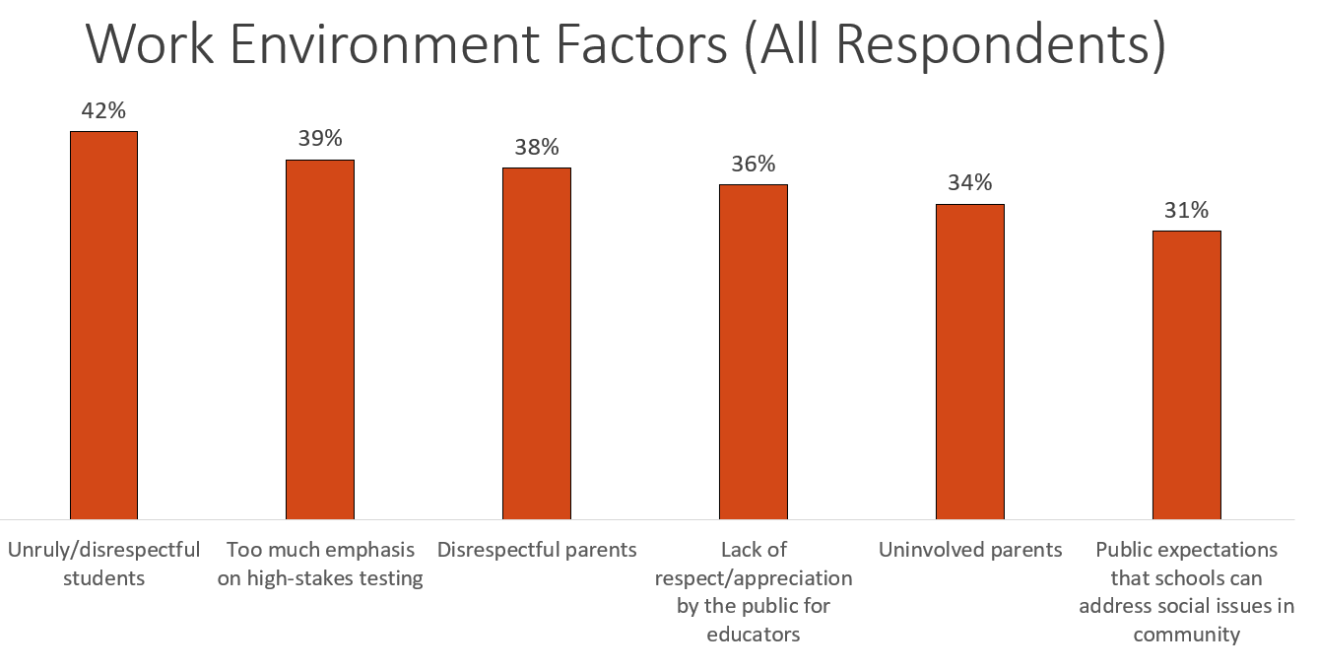
Studying the Teacher Pipeline

Slide 27
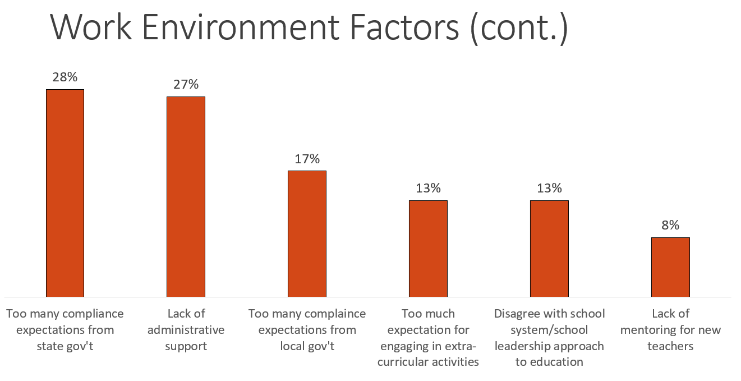
Studying the Teacher Pipeline

Slide 28
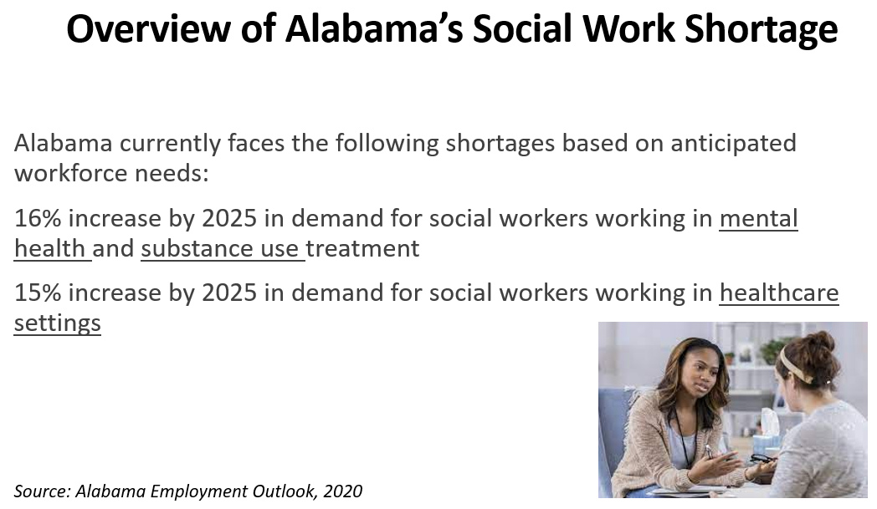
Studying Social Work Graduates in Workforce

Slide 29
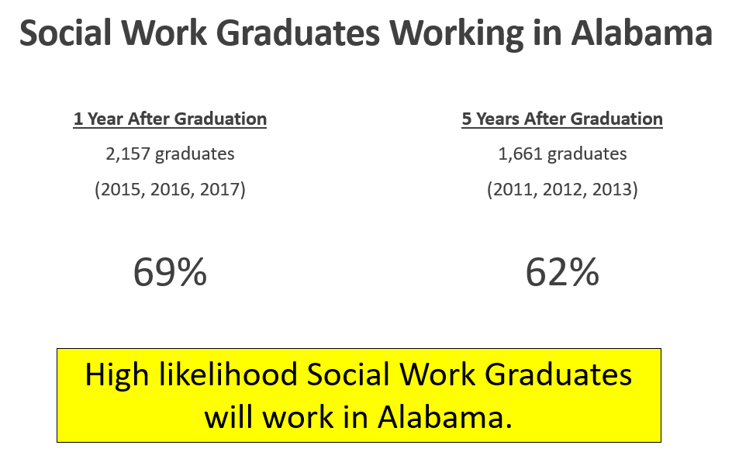
Studying Social Work Graduates in Workforce

Slide 30
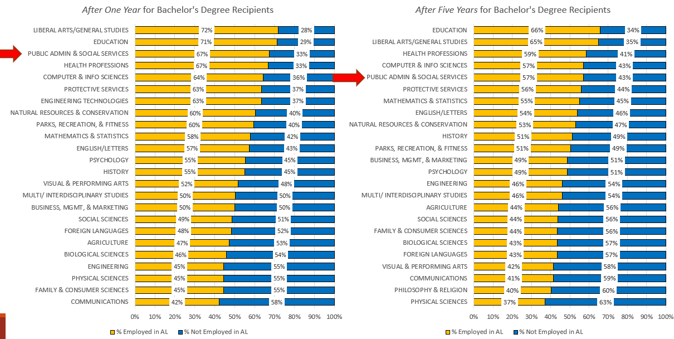
Studying Social Work Graduates in Workforce

Slide 31
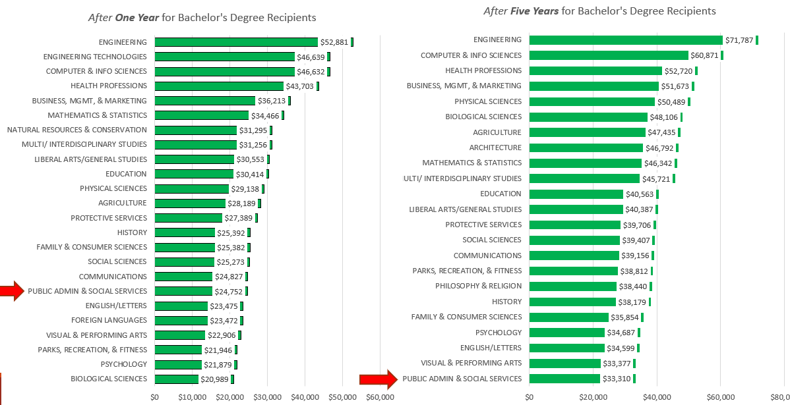
Studying Social Work Graduates in Workforce

Slide 32
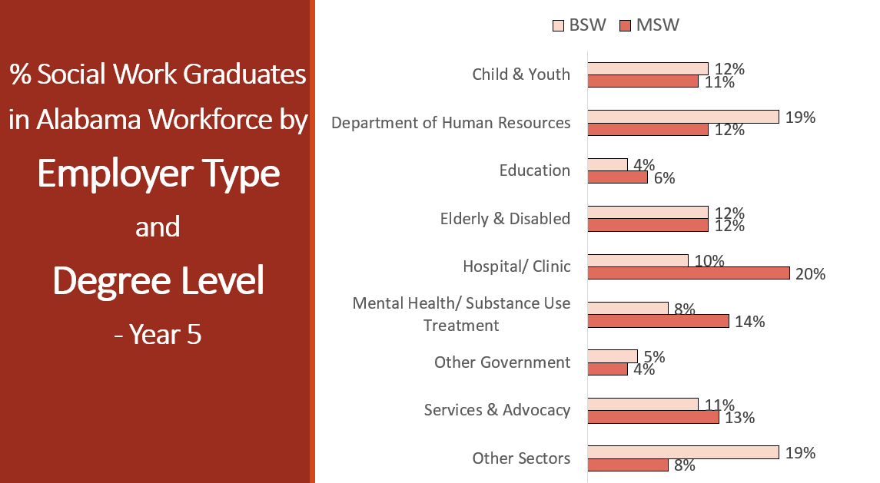
Studying Social Work Graduates in Workforce

Slide 33
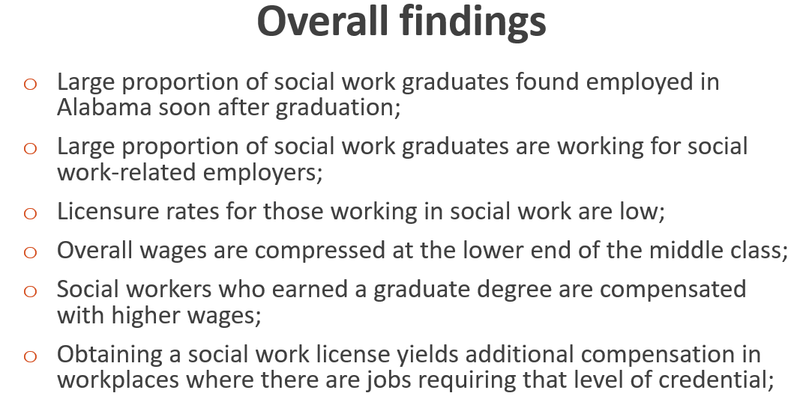
Studying Social Work Graduates in Workforce

Slide 34
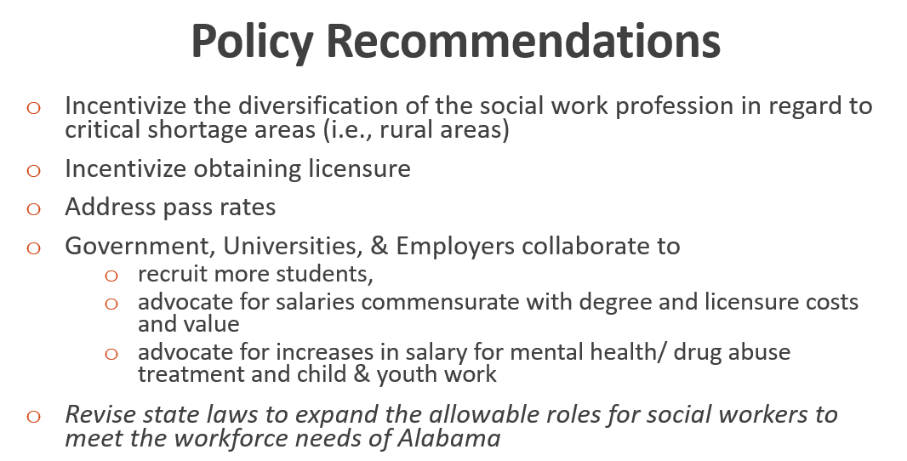
Studying Social Work Graduates in Workforce

Slide 35
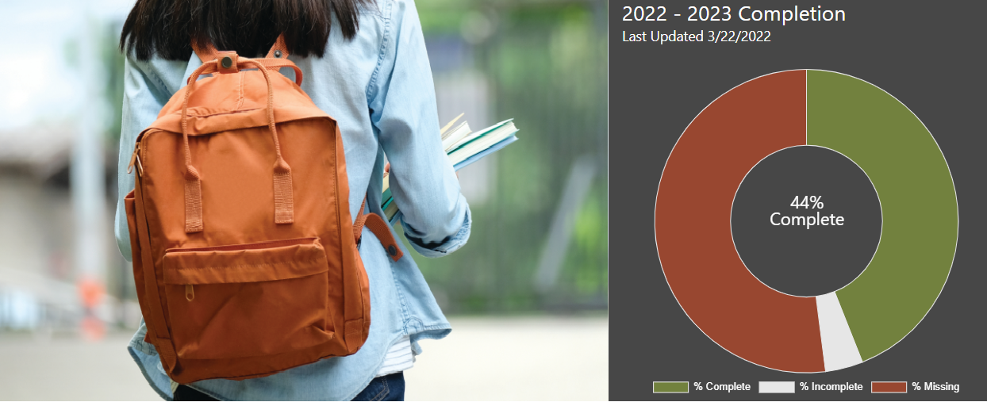
Improving FAFSA Completion
fafsa.ache.edu

Slide 36
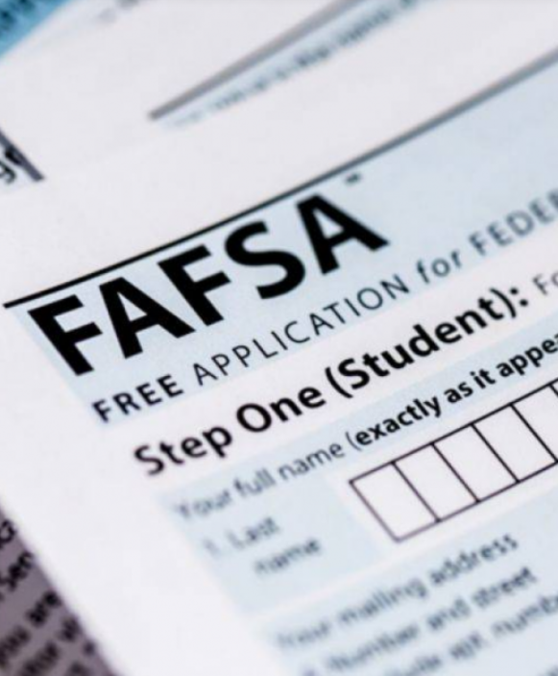
Why is completing the FAFSA important?
A gateway to over $150 billion in federal aid, and most state and institution aid.
Alabama’s Class of 2021 left roughly $67.8 million in unclaimed Pell Grant money on the table (ranked 15th nationally).
FAFSA completion strongly associated with positive outcomes:
92% of seniors who completed FAFSA enrolled in college or university following graduation
Education linked to higher incomes, better health, more civic engagement

Slide 37
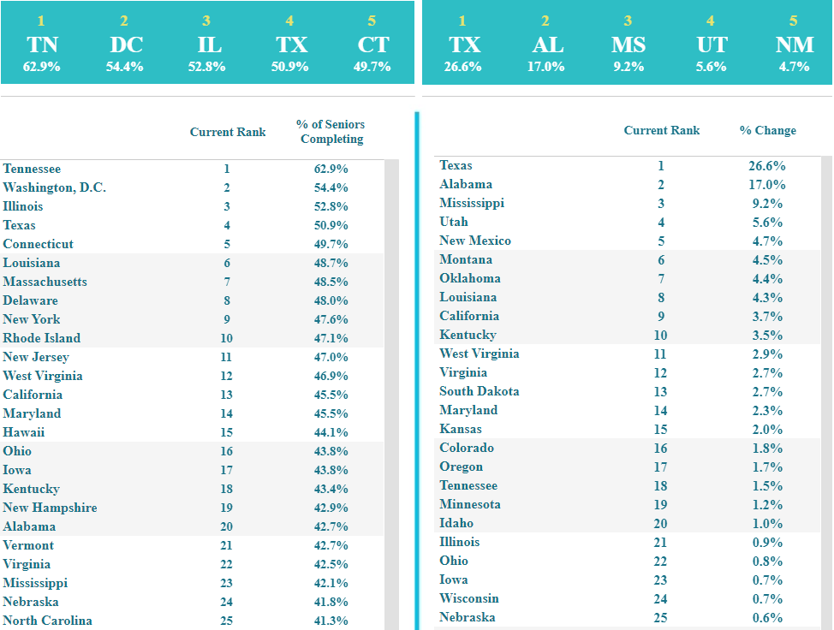
FAFSA Completion State Rankings:
20th nationally in overall completion
(42.7% completion)
2nd nationally in 1-year improvement
(17.0% increase)
Source: www.ncan.org

Slide 38
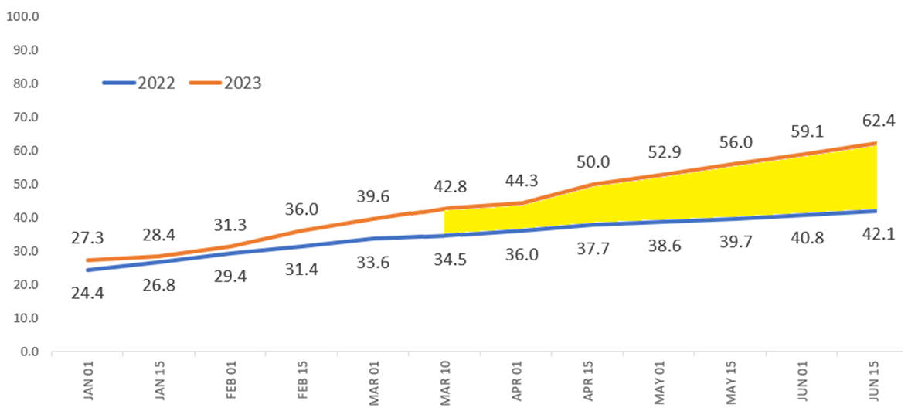
ACHE FAFSA Completion Portal Trend and Projected Data as of 3/10/2022
100% Completion Goal
Projected
Current

Slide 39
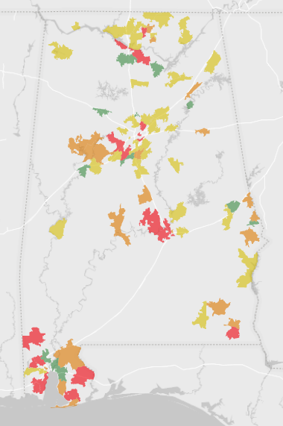
FAFSA Completion Areas of Concern Based on Latest 2-Year Averages
5 key areas with high enrollment and low completion rates:
Mobile
Montgomery
Birmingham
Huntsville
Dothan
Includes 105 high schools (35.0%) enrolling 30,038 students (63.1%)
Excludes high schools with less than 150 students

Slide 40
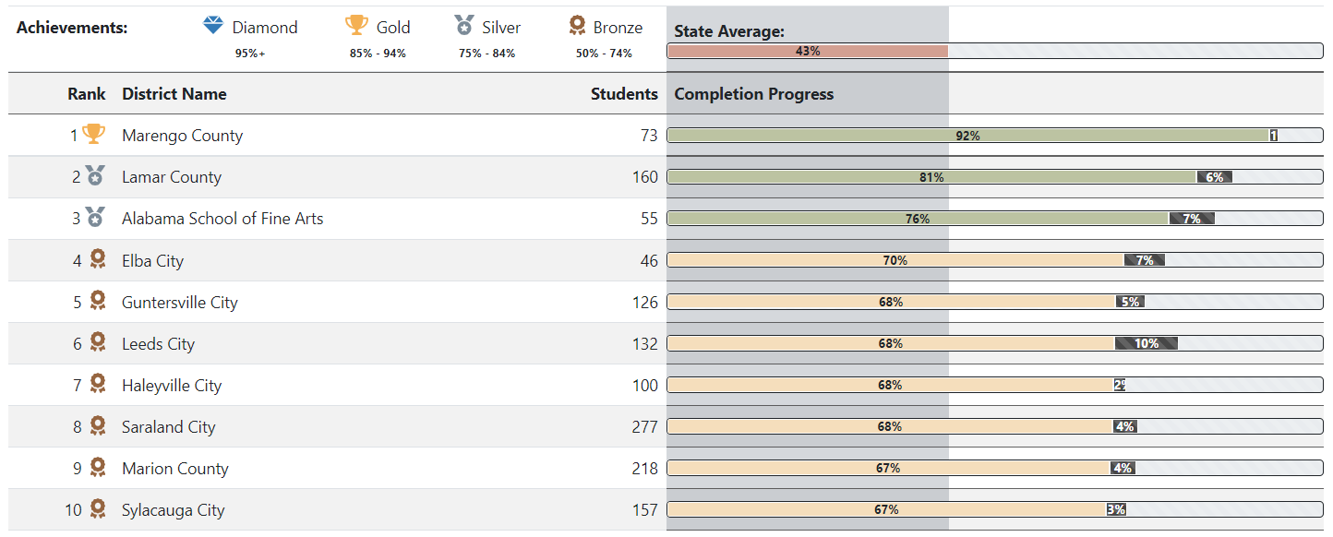
District Top 10 for Academic Year 2022-23, so far
As of 3/10/2022

Slide 41
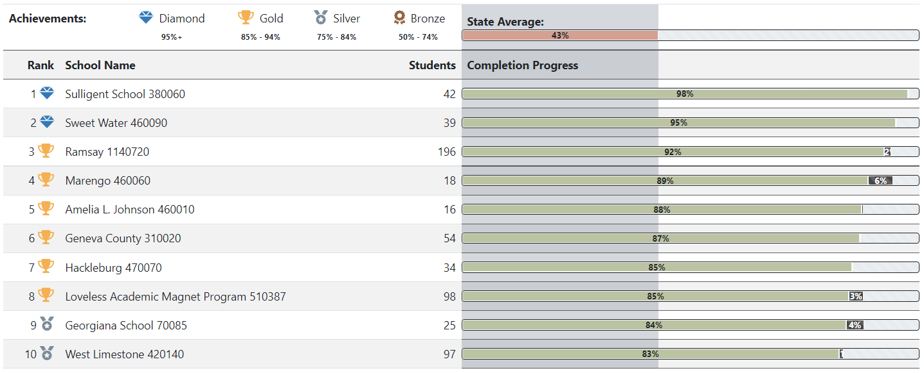
All High Schools: High School Top 10 for Academic Year 2022-23, so far
As of 3/10/2022

Slide 42
Developing Retain and Recall Alabama
Two initiatives designed to contact former graduates who have left the state – and encourage (market) their return.
Three phases:
Data mining project to update contact information with third party vendor
Digital marketing campaign designed to target former graduates and encourage their return
Identify geographical areas (Dallas, Nashville, etc.) of former graduates and host events

Slide 43
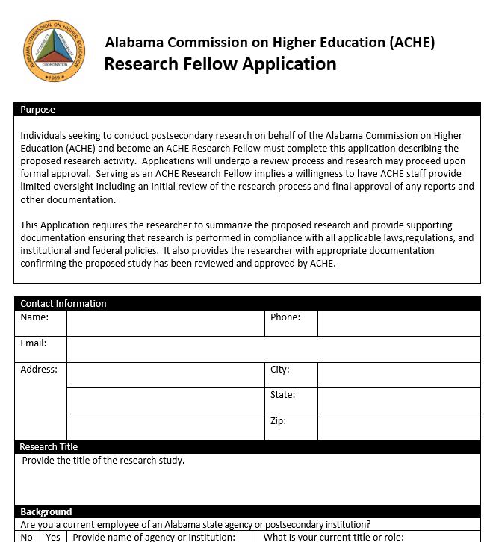
Searching for ACHE Research Fellows
Promotes research on higher education in Alabama
Stipends available to support research activity
Receive recognition as an ACHE Research Fellow
Develop research credentials and portfolio
AL Dept of Labor data available (with limitations)
Individual and joint projects accepted
For more information, contact:
jim.hood@ache.edu , 334.242.2209

Slide 44
How can ACHE better support your work?
Periodic Town Hall Discussions
Academic Program Inventory
Workforce Outcomes
Coordinate Communication (i.e. surveys)
Facilitate Exploratory Groups (TRP)
Enrollment Forecasting
Peer/Comparison Group Development
Accountability metrics
Data Visualization Best Practices
Salary Studies
Micro-Credentialing
Predictive Analytics, etc.

Slide 45
Thank you….and keep rowing!
Jim Hood, Ph.D. | jim.hood@ache.edu
jimhoodphd

