Slide 1

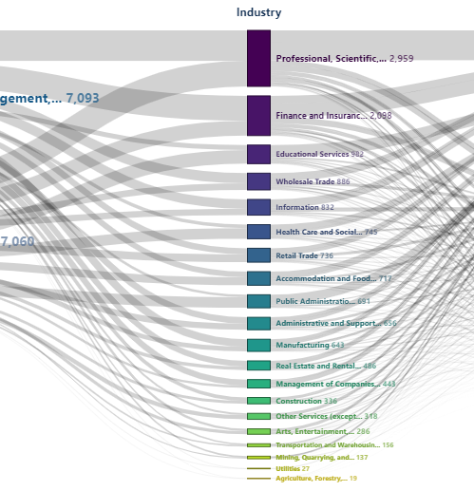

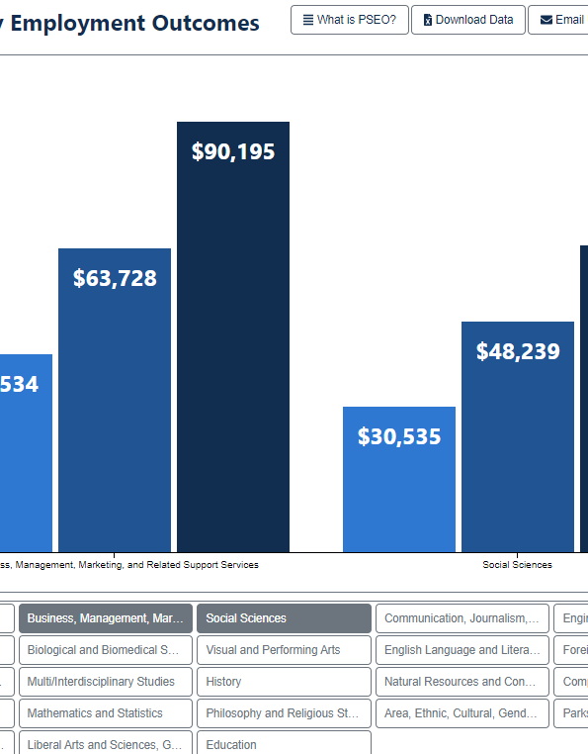


College Selectivity, Choice of Major, and Post-College Earnings
Iryna Y. Muse

Slide 2
Presentation Outline
College Scorecard: Post-Completion Earnings by Field of Study
Human Capital Theory and Bourdieu’s Distinction
What is cross-classified model? Why logarithmic transformation of the dependent variable?
Independent Variables: Institutional Characteristics: Selectivity, Location, etc.
Independent Variables, Disciplinary Characteristics, STEM
Independent Variables, Programs within Institutions: Race, Gender, Interactions
Unconditional Model: Disciplines and institutions with highest and lowest earnings
STEM Model: Institutions with lowest and highest effects of STEM
Final Model and Expected Earnings

Slide 3

Board Rule 502: Establishing New Programs
Guidelines and procedures for the development, submission, review, and approval of new programs are developed and administered by the System’s Office of Academic Affairs.

Slide 4
Equitable Value Explorer
SUG Institutions
The institutions that are always on the top of the rankings—places like Harvard, Princeton and Stanford Universities—enroll students who are destined to succeed, the critics say. It should be no surprise (and not worthy of praise) that the students then do well” (Jaschik 2018).
Percentage of STEM students and the difference between the minimum economic return (T0) and median earnings
Percentage of Pell students and the difference between the minimum economic return (T0) and median earnings
Notes:
On November 4, 2021, Bill and Melinda Gates Foundation’s Postsecondary Value Commission introduced the Equitable Value Explorer. Using several data sources—including the Integrated Postsecondary Education Data System (IPEDS), The U.S. Census Bureau’s Academic Community Survey (ACS), and College Scorecard data—they construct a set of variables and compare median earnings of students receiving federal financial aid (based on College Scorecard data) with median earnings of a comparison population from ACS adjusted by the cost of attendance estimated using IPEDS data. To evaluate the economic value of post-secondary institutions, they use the following thresholds (see Data Documentation):
(T0) Minimum Economic Return: Median earnings of workers with positive earnings in the same state the institution is located and with a High School Degree (or GED) as their highest level of educational attainment, plus yearly amortized total cost of obtaining the credential.
(T1) Earnings Premium: Median earnings of workers with positive earnings in the same state with the same level of degree (BA or AA) as the predominant credential awarded by the institution.
(T3) Earnings Mobility: The 60th percentile of earnings among workers with positive earnings in the same state the institution is located regardless of educational attainment.
https://equity.postsecondaryvalue.org/datatool

Slide 5
College Scorecard
IPEDS
NSLDS
IRS
Post-Completion Earnings by Field of Study
The College Scorecard is a data product released by the U.S. Department of Education beginning in 2013 and focuses on students and their earnings.
The Department of Education produces this product by matching federal financial aid data (based on the National Students Loan Data System) to IRS tax records. Only students who received federal aid are included.
Graduates who worked, did not enroll in measurement year, and did not receive a higher-level credential are included to estimate median earnings.
Recently College Scorecard started to include information by field of study. Field of study most recent datafile includes students entering repayment from July 1, 2015 – June 30, 2017 and earnings measured in 2017 and in 2018.

Slide 6
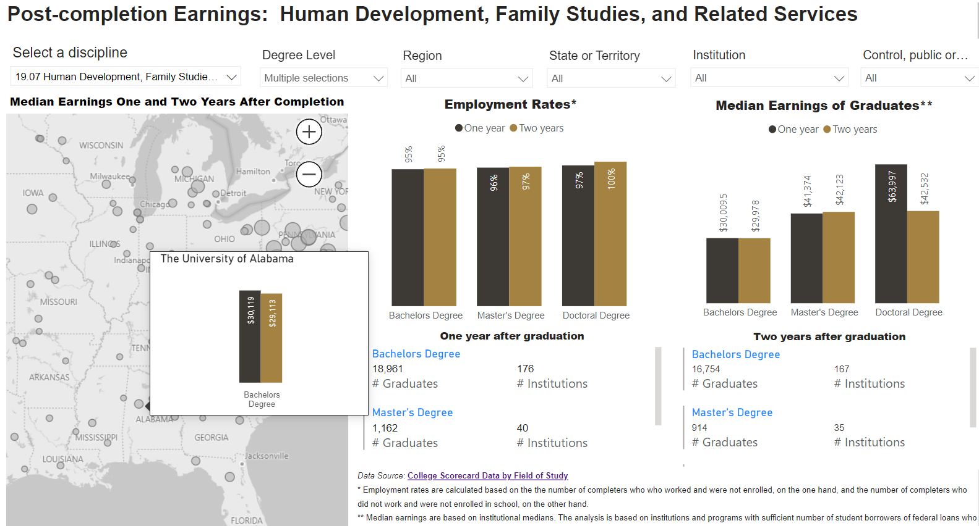
College Scorecard Data
Notes:
https://app.powerbi.com/view?r=eyJrIjoiNDVjMDQ0NmUtOGI3Ni00ZjU1LThjZDctYjc1NmNlZjE0NmJlIiwidCI6IjJhMDA3MjhlLWYwZDAtNDBiNC1hNGU4LWNlNDMzZjNmYmNhNyIsImMiOjN9

Slide 7
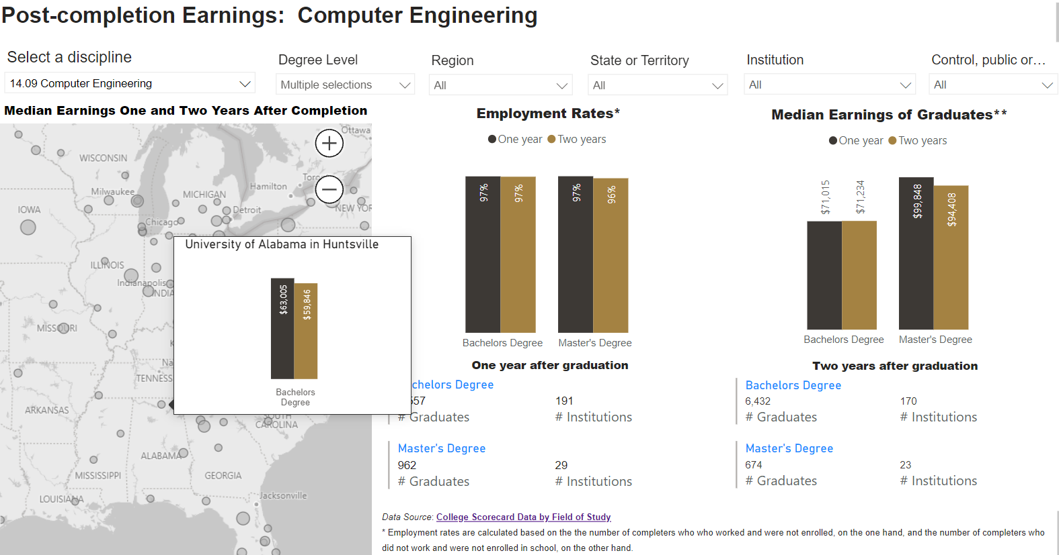
College Scorecard Data
Notes:
https://app.powerbi.com/view?r=eyJrIjoiNDVjMDQ0NmUtOGI3Ni00ZjU1LThjZDctYjc1NmNlZjE0NmJlIiwidCI6IjJhMDA3MjhlLWYwZDAtNDBiNC1hNGU4LWNlNDMzZjNmYmNhNyIsImMiOjN9

Slide 8

Human Capital Theory
To most people, capital means a bank account, a hundred shares of IBM stock, assembly lines, or steel plants in the Chicago area. These are all forms of capital in the sense that they are assets that yield income and other useful outputs over long periods of time.
Notes:
But such tangible forms of capital are not the only type of capital. Schooling, a computer training course, expenditures on medical care, and lectures on the virtues of punctuality and honesty are also capital. That is because they raise earnings, improve health, or add to a person’s good habits over much of his lifetime. Therefore, economists regard expenditures on education, training, medical care, and so on as investments in human capital. They are called human capital because people cannot be separated from their knowledge, skills, health, or values in the way they can be separated from their financial and physical assets.
Education, training, and health are the most important investments in human capital. Many studies have shown that high school and college education in the United States greatly raise a person’s income, even after netting out direct and indirect costs of schooling, and even after adjusting for the fact that people with more education tend to have higher IQs and better-educated, richer parents. Similar evidence covering many years is now available from more than a hundred countries with different cultures and economic systems. The earnings of more-educated people are almost always well above average, although the gains are generally larger in less-developed countries.
Gary S. Becker

Slide 9

Bourdieu’s Distinction
Bourdieu on Kinds of Capital
Economic capital (what you have)
Cultural capital (what you know)
Social capital (who you know)
Individuals are habituated to distinguish themselves from others:
Those from more advantaged backgrounds, such as continuing-generation students, tend to distinguish themselves from those in lower social positions by distancing themselves from necessity. For example, one can distance oneself from necessity by choosing a major that is not associated with high pay.
Less advantaged individuals, such as first-generation students, distinguish themselves from those in higher social positions by making a virtue of necessity. They do so by making economical choices.

Slide 10
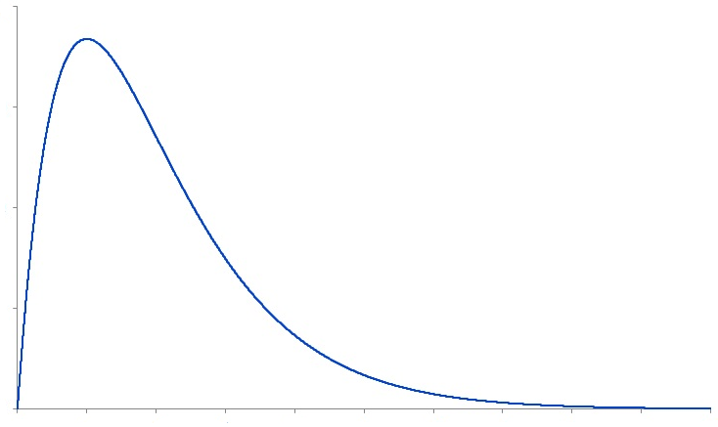

Log-linear model
Each 1-unit increase in X multiplies the expected value of Y by exp(β).
Transformation for a skewed distribution
Notes:
Income or earnings are a textbook example of a positively skewed distribution. And the distributions of medians at a college and disciplinary levels remain positively skewed. Skewness (and standard error of skewness) of median earnings is 1.243 (0.014) for data on one year after entering repayment and 1.209 (0.014) for two years after entering repayment. Logarithmic transformations are a common practice of transforming a highly skewed variable into one that is more approximately normal (Benoit 2011). For data in this study, skewness (and standard error of skewness) of a natural logarithm of median earnings is 0.179 (0.014) one year after entering repayment and 0.128 (0.014) two years after entering repayment. Logarithmic transformation of the dependent variable also helps with interpretation of the regression coefficients. With natural logarithm of earnings as a dependent variable, a one unit increase in independent variable multiplies the expected median earnings by e to the power of a regression coefficient.

Slide 11
Cross-Classified Model
Observations within disciplines and institutions
. . .
Level 2: Discipline
. . .
Level 1: Discipline within Institution
. . .
Level 2: Institution

Slide 12

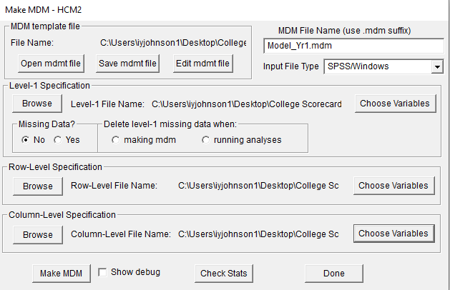
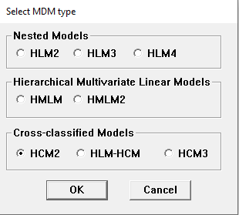
Cross-Classified Model
Structure

Slide 13
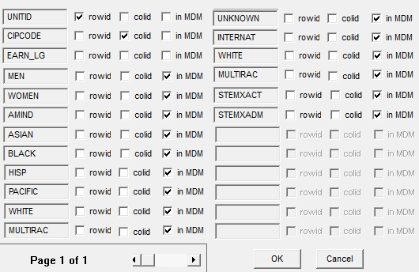
Cross-Classified Model
Level 1: Disciplines within Institutions

Slide 14
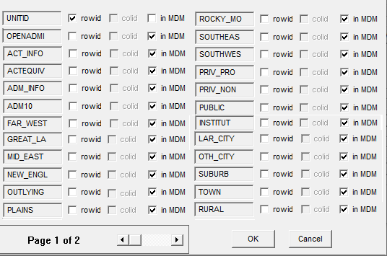
Cross-Classified Model
Level 2: Institutions

Slide 15
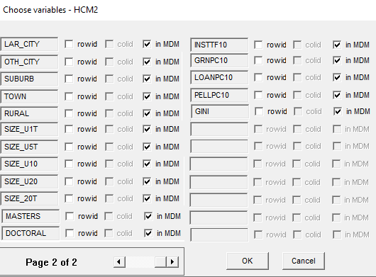
Cross-Classified Model
Level 2: Institutions

Slide 16
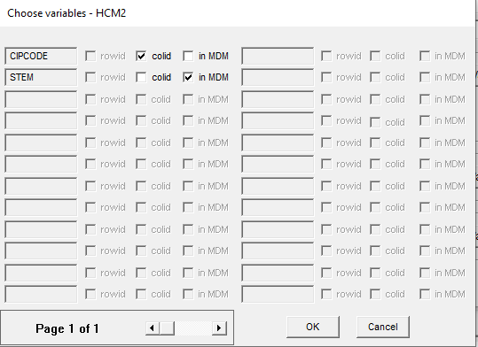
Cross-Classified Model
Level 2: Disciplines

Slide 17
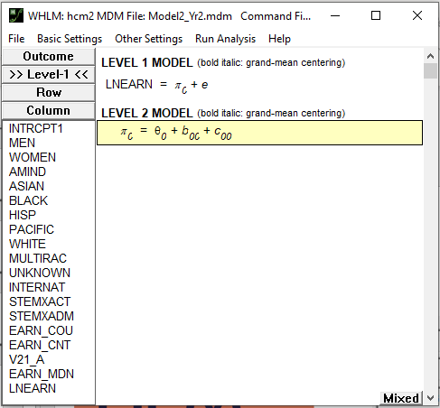

Unconditional Model

Slide 18



Unconditional Model
Disciplines with highest salaries (one year after entering repayment)
Petroleum Engineering (CIPC 14.25; expected median $71,146; N=20 [based on 20 institutions])
Computational Science (CIPC 30.30; expected median $65,163; N=1)
Electrical, Electronics and Communications Engineering (CIPC 14.10; expected median $64,546; N=288)
Mining and Mineral Engineering (CIPC 14.21; expected median $64,529; N=10)
Computer Engineering (CIPC 14.09; expected median $63,783; N=199)
Naval Architecture and Marine Engineering (CIPC 14.22; expected median $62,790; N=6)
Registered Nursing, Nursing Administration, Nursing Research and Clinical Nursing (CIPC 51.38; expected median $62,179; N=1,020)
Construction Engineering Technologies (CIPC 15.10; expected median $62,056; N=43)
Construction Engineering (CIPC 14.33; expected median $61,826; N=16)
Industrial Engineering (CIPC 14.35; expected median $61,813; N=90)
After control for disciplines, institutions with top five expected salaries one year after entering repayment included private non-profit institutions: California Institute of Technology, CA ($64,123; N=3 [based on three programs]); Massachusetts Institute of Technology, MA ($62,592; N=14); Harvard University, MA ($61,642; N=16); Harvey Mudd College, CA ($61,124; N=4); and Yale University, CT ($60,693; N=13).
Notes:
The proportions of variances that can explained by the institutional level are 22% one year after entering repayment and 21% two years after entering repayment. The proportion of variance that can be explained by disciplinary level is 60% one and two years after entering repayment. Thus, the unconditional model clearly demonstrates that disciplinary level is more consequential for student earnings than the institutional level.

Slide 19
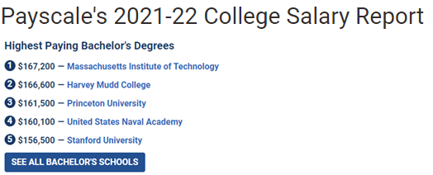

Harvey Mudd College, CA
Harvey Mudd College admissions is more selective with an acceptance rate of 18%. Half the applicants admitted to Harvey Mudd College have an SAT score between 1490 and 1570 or an ACT score of 34 and 35. However, one quarter of admitted applicants achieved scores above these ranges and one quarter scored below these ranges.
Source: U.S. News & World Report
CIPCODE | CIPDESC | EARN_MDN
11.07 | Computer Science. | $141,586
14.01 | Engineering, General. | $78,343
27.01 | Mathematics. | $64,990
30.08 | Mathematics and Computer Science. | $136,278
Notes:
Private, not for profit

Slide 20
STEM Model
Institutions with lowest and highest effects of STEM
Institution | N |  |  | Stem | Non-Stem |  | Diff. | % Diff.
One year after entering repayment; lowest effects of STEM
Fordham University, NY |  | 28 |  | $49,305 |  | $41,812 | $7,493 |  |  | 18%
Massachusetts Institute of Technology, MA |  | 14 |  | $71,624 |  | $60,531 | $11,093 |  |  | 18%
University of Miami, FL |  | 40 |  | $41,108 |  | $34,711 | $6,397 |  |  | 18%
Colgate University, NY |  | 17 |  | $57,095 |  | $48,159 | $8,936 |  |  | 19%
CUNY New York City College of Technology, NY |  | 16 |  | $43,579 |  | $36,720 | $6,858 |  |  | 19%
One year after entering repayment; highest effects of STEM
Pontifical Catholic University of PR-Ponce, PR |  | 17 | $24,579 |  | $16,256 |  | $8,322 |  | 51%
University of Puerto Rico-Humacao, PR |  | 7 | $23,920 |  | $15,518 |  | $8,402 |  | 54%
Atenas College, PR |  | 2 | $19,560 |  | $12,651 |  | $6,909 |  | 55%
Inter American University of PR-Aguadilla, PR |  | 2 | $18,775 |  | $12,043 |  | $6,732 |  | 56%
Inter American University of PR-Guayama, PR |  | 5 | $18,959 |  | $11,812 |  | $7,147 |  | 61%
Notes:
The proportions of variances that can explained by the institutional level are 22% one year after entering repayment and 21% two years after entering repayment. The proportion of variance that can be explained by disciplinary level is 60% one and two years after entering repayment. Thus, the unconditional model clearly demonstrates that disciplinary level is more consequential for student earnings than the institutional level.

Slide 21
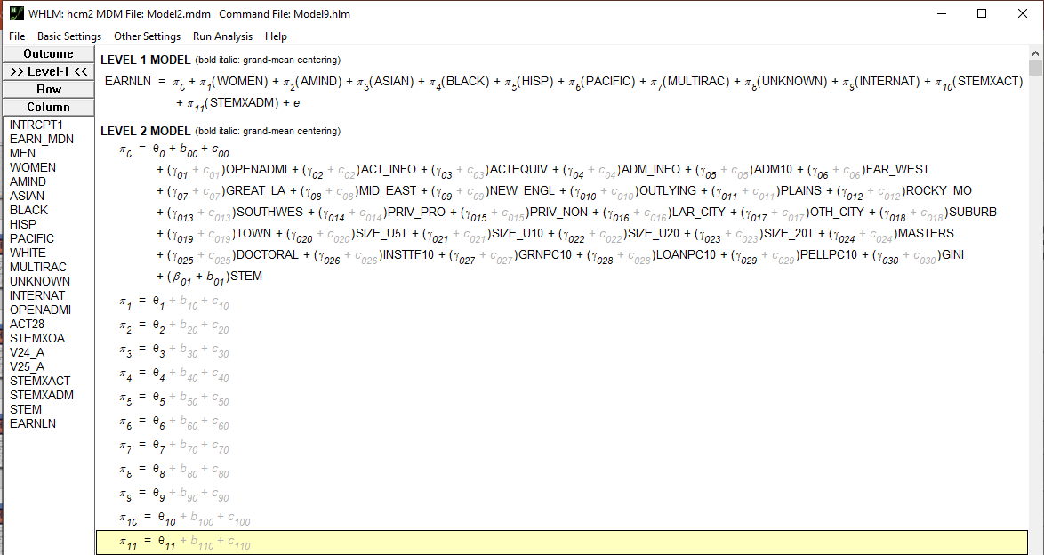
Final Model

Slide 22
Disciplines: STEM and non-STEM
One year after entering repayment
Two years after entering repayment
Notes:
https://app.powerbi.com/view?r=eyJrIjoiNDVjMDQ0NmUtOGI3Ni00ZjU1LThjZDctYjc1NmNlZjE0NmJlIiwidCI6IjJhMDA3MjhlLWYwZDAtNDBiNC1hNGU4LWNlNDMzZjNmYmNhNyIsImMiOjN9

Slide 23
Selectivity: Open Admissions
One year after entering repayment
Two years after entering repayment
Notes:
https://app.powerbi.com/view?r=eyJrIjoiNDVjMDQ0NmUtOGI3Ni00ZjU1LThjZDctYjc1NmNlZjE0NmJlIiwidCI6IjJhMDA3MjhlLWYwZDAtNDBiNC1hNGU4LWNlNDMzZjNmYmNhNyIsImMiOjN9

Slide 24
Selectivity: ACT or SAT Equivalent
One year after entering repayment
Two years after entering repayment
Notes:
https://app.powerbi.com/view?r=eyJrIjoiNDVjMDQ0NmUtOGI3Ni00ZjU1LThjZDctYjc1NmNlZjE0NmJlIiwidCI6IjJhMDA3MjhlLWYwZDAtNDBiNC1hNGU4LWNlNDMzZjNmYmNhNyIsImMiOjN9

Slide 25
Selectivity: Admission Rate
One year after entering repayment
Two years after entering repayment
Notes:
https://app.powerbi.com/view?r=eyJrIjoiNDVjMDQ0NmUtOGI3Ni00ZjU1LThjZDctYjc1NmNlZjE0NmJlIiwidCI6IjJhMDA3MjhlLWYwZDAtNDBiNC1hNGU4LWNlNDMzZjNmYmNhNyIsImMiOjN9

Slide 26
Location of the Institution
One year after entering repayment
Two years after entering repayment
Notes:
https://app.powerbi.com/view?r=eyJrIjoiNDVjMDQ0NmUtOGI3Ni00ZjU1LThjZDctYjc1NmNlZjE0NmJlIiwidCI6IjJhMDA3MjhlLWYwZDAtNDBiNC1hNGU4LWNlNDMzZjNmYmNhNyIsImMiOjN9

Slide 27
Control of the Institution
One year after entering repayment
Two years after entering repayment
 | Avg ACT | % Reported ACT
Private, for-profit | 20.5 | 2%
Private, nonprofit | 23.3 | 61%
Public | 22.4 | 73%
 | Avg ACT | % Reported ACT
Private, for-profit | 20.5 | 2%
Private, nonprofit | 23.3 | 62%
Public | 22.4 | 74%
Notes:
https://app.powerbi.com/view?r=eyJrIjoiNDVjMDQ0NmUtOGI3Ni00ZjU1LThjZDctYjc1NmNlZjE0NmJlIiwidCI6IjJhMDA3MjhlLWYwZDAtNDBiNC1hNGU4LWNlNDMzZjNmYmNhNyIsImMiOjN9
High salary for private non-profit institutions is not observed in raw data, but once other characteristics are at average . . .
Private non-profit institutions are less likely to report ACT scores; and , when ACT scores are reported, they are lower.

Slide 28
Urbanization
One year after entering repayment
Two years after entering repayment
No statistically significant differences
No statistically significant differences
Notes:
https://app.powerbi.com/view?r=eyJrIjoiNDVjMDQ0NmUtOGI3Ni00ZjU1LThjZDctYjc1NmNlZjE0NmJlIiwidCI6IjJhMDA3MjhlLWYwZDAtNDBiNC1hNGU4LWNlNDMzZjNmYmNhNyIsImMiOjN9
Despite being less selective, private for profit institutions are associated with slightly higher salaries . . . These are those who graduate though . . . Observed values are also higher? Could it be because they cut unprofitable programs?

Slide 29
Size of the Institution
One year after entering repayment
Two years after entering repayment
Notes:
https://app.powerbi.com/view?r=eyJrIjoiNDVjMDQ0NmUtOGI3Ni00ZjU1LThjZDctYjc1NmNlZjE0NmJlIiwidCI6IjJhMDA3MjhlLWYwZDAtNDBiNC1hNGU4LWNlNDMzZjNmYmNhNyIsImMiOjN9
Despite being less selective, private for profit institutions are associated with slightly higher salaries . . . These are those who graduate though . . . Observed values are also higher? Could it be because they cut unprofitable programs?

Slide 30
Level of the Institution
One year after entering repayment
Two years after entering repayment
Notes:
https://app.powerbi.com/view?r=eyJrIjoiNDVjMDQ0NmUtOGI3Ni00ZjU1LThjZDctYjc1NmNlZjE0NmJlIiwidCI6IjJhMDA3MjhlLWYwZDAtNDBiNC1hNGU4LWNlNDMzZjNmYmNhNyIsImMiOjN9
Despite being less selective, private for profit institutions are associated with slightly higher salaries . . . These are those who graduate though . . . Observed values are also higher? Could it be because they cut unprofitable programs?

Slide 31
In-State Tuition
One year after entering repayment
Two years after entering repayment
Notes:
https://app.powerbi.com/view?r=eyJrIjoiNDVjMDQ0NmUtOGI3Ni00ZjU1LThjZDctYjc1NmNlZjE0NmJlIiwidCI6IjJhMDA3MjhlLWYwZDAtNDBiNC1hNGU4LWNlNDMzZjNmYmNhNyIsImMiOjN9
Despite being less selective, private for profit institutions are associated with slightly higher salaries . . . These are those who graduate though . . . Observed values are also higher? Could it be because they cut unprofitable programs?

Slide 32
Share of Undergraduates Receiving Aid
One year after entering repayment
Two years after entering repayment
Notes:
https://app.powerbi.com/view?r=eyJrIjoiNDVjMDQ0NmUtOGI3Ni00ZjU1LThjZDctYjc1NmNlZjE0NmJlIiwidCI6IjJhMDA3MjhlLWYwZDAtNDBiNC1hNGU4LWNlNDMzZjNmYmNhNyIsImMiOjN9
Despite being less selective, private for profit institutions are associated with slightly higher salaries . . . These are those who graduate though . . . Observed values are also higher? Could it be because they cut unprofitable programs?

Slide 33
Share of Women in the Program
One year after entering repayment
Two years after entering repayment
Notes:
https://app.powerbi.com/view?r=eyJrIjoiNDVjMDQ0NmUtOGI3Ni00ZjU1LThjZDctYjc1NmNlZjE0NmJlIiwidCI6IjJhMDA3MjhlLWYwZDAtNDBiNC1hNGU4LWNlNDMzZjNmYmNhNyIsImMiOjN9
Despite being less selective, private for profit institutions are associated with slightly higher salaries . . . These are those who graduate though . . . Observed values are also higher? Could it be because they cut unprofitable programs?

Slide 34
Racial Composition of the Program
One year after entering repayment
Two years after entering repayment
Notes:
https://app.powerbi.com/view?r=eyJrIjoiNDVjMDQ0NmUtOGI3Ni00ZjU1LThjZDctYjc1NmNlZjE0NmJlIiwidCI6IjJhMDA3MjhlLWYwZDAtNDBiNC1hNGU4LWNlNDMzZjNmYmNhNyIsImMiOjN9
Despite being less selective, private for profit institutions are associated with slightly higher salaries . . . These are those who graduate though . . . Observed values are also higher? Could it be because they cut unprofitable programs?

Slide 35
Selectivity (ACT) and STEM
Two years after entering repayment
One year after entering repayment
Interaction effect is not statistically significant
Notes:
https://app.powerbi.com/view?r=eyJrIjoiNDVjMDQ0NmUtOGI3Ni00ZjU1LThjZDctYjc1NmNlZjE0NmJlIiwidCI6IjJhMDA3MjhlLWYwZDAtNDBiNC1hNGU4LWNlNDMzZjNmYmNhNyIsImMiOjN9

Slide 36
Selectivity (Admission Rate) and STEM
One year after entering repayment
Two years after entering repayment
Notes:
https://app.powerbi.com/view?r=eyJrIjoiNDVjMDQ0NmUtOGI3Ni00ZjU1LThjZDctYjc1NmNlZjE0NmJlIiwidCI6IjJhMDA3MjhlLWYwZDAtNDBiNC1hNGU4LWNlNDMzZjNmYmNhNyIsImMiOjN9

Slide 37
Questions? Concerns?

