Slide 1

Guiding Organizational Improvement
Jim Purcell, Ed.D., Executive Director,
Alabama Commission on Higher Education

Slide 2
Your role
Who you serve
Prioritizing your work
Building Human Capital

Slide 3

1. You are the intermediary between reality and rhetoric
Reality sometimes needs an advocate
Sometimes scholarly findings will not apply to a specific institution
Occasionally an institution looks poorly on a given data point, but for good reasons
While you have a lot of reporting work to do, your job is to help the organization achieves its intended purpose
Impact of High Risk Indicators on Student Success

Slide 4

2. The IR role as articulated in the the IR Code of Ethics
Benchmarking for a Public Liberal Arts University.
Assessing the life and times of first semester academic failures
Be Objective - Clarify the purposes, expectations, strategies, and limitations of the research
Do not claim competence in areas where you lack and do not accept assignments where it cannot be gained.
Seek professional development for self and your staff.
Ensure that all reports of projects are complete; in language understandable to decision-makers. Make efforts to prevent misunderstandings and misuse.
Accept responsibility of all assignments including quality of secondary data.
Document. Document. Document.
Assure data confidentiality, security, storage, and archiving are foolproof.
External Reporting. Engage in responsible reporting.
Seek opportunities to contribute to the profession.
Uphold and advance the IR values and ethics.

Slide 8
2. Your role is articulated in the the IR Code of Ethics
Be Objective - Clarify the purposes, expectations, strategies, and limitations of the research
Do not claim competence in areas where you lack and do not accept assignments where it cannot be gained.
Seek professional development for self and your staff.
Ensure that all reports of projects are complete; in language understandable to decision-makers. Make efforts to prevent misunderstandings and misuse.
Accept responsibility of all assignments including quality of secondary data.
Document. Document. Document.
Assure data confidentiality, security, storage, and archiving are foolproof.
External Reporting. Engage in responsible reporting.
Seek opportunities to contribute to the profession.
Uphold and advance the IR values and ethics.
Benchmarking for a Public Liberal Arts University.
Assessing the life and times of first semester academic failures

Slide 9
GC&SU- 2002 Survey

Slide 10
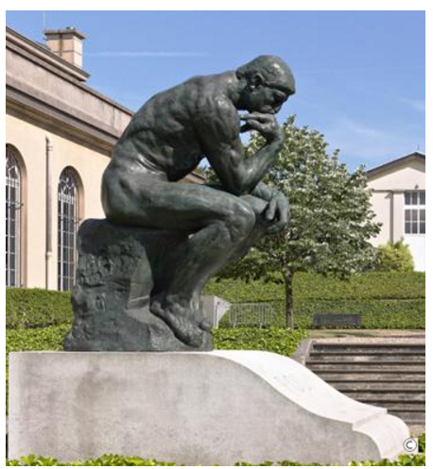
The great idea
“Pause to think day”
  Mid-semester event to celebrate intellectuality. (Speakers, intellectual activities, etc.)
  Assessment
    Pause to drink day
  Redesign
    No more day.

Slide 11


3. Supporting the President/CEO
No other interaction can impact an organization's success more than the sharing of quality information and perspective between the IR staff and the chief executive officer
The future direction of the campus—the institutional vision—is the dominating purview of the campus president.
Direct line of communication is best, but not necessary
Trust is the key
Provide information and trends that:
  identifies possibilities for the future
  determines where to intervene
  monitors the strategic plan
Advisor to the King

Slide 12
3. Supporting the President/CEO
The true measure of an IR office is the success of the institution, the president, and the institutional plan.

Slide 13
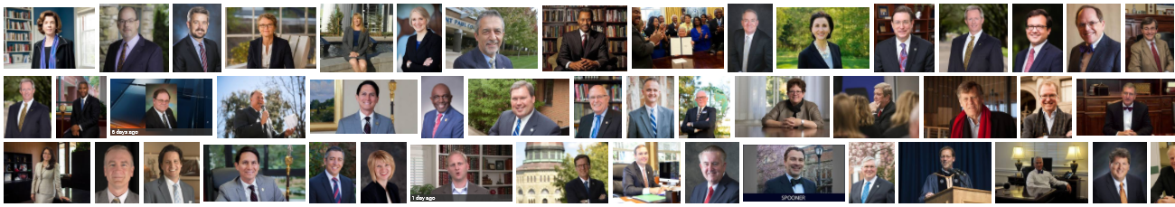
3. Supporting the President/CEO
Presidential Realities
Reality 1. More often than not, the campus president will not have leadership experience in governing all aspects of a campus.
Only about one in five (21 percent) had served as a college president prior to becoming president at a current campus.
Academic vice presidents and provosts account for 43 percent of presidents
Another 13 percent come from outside higher education
(Chronicle of Higher Education).

Slide 14
Expenditures by Category
Yellow: highest in Category
Grey: lowest in Category
Tan: of interest

Slide 15
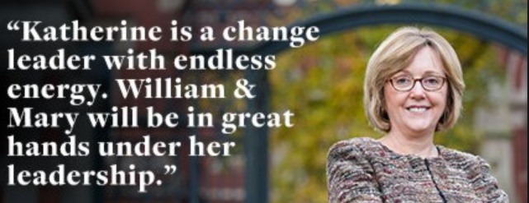
3. Supporting the President/CEO
Presidential Realities
Reality 2. New Presidents are especially vulnerable to unfettered enthusiasm for change.
The rationale and the strategy for change needs to be developed based on facts. A seasoned IR director can be an ideal source for identifying issues, suggesting effective approaches and documenting success.
Trends and projections are more important to a campus CEO than the day-to-day managerial assessments provided to vice presidents and deans.

Slide 16

3. Supporting the President/CEO
Presidential Realities
Reality 3. Time is short.
The time pressures and eclectic roles of modern institutional presidents often limit the opportunities to “discover” on their own.
Presidents welcome conclusions and informed recommendations.
IR staff should examine the plethora of data, synthesize it into the essential points, and reveal points of opportunity and concern.
“It is the value of the information that matters.” –Larry Jones

Slide 17
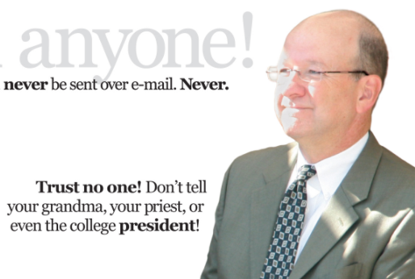
3. Supporting the President/CEO
Presidential Realities
Reality 4. Trust is a terrible thing to waste
Be an honest broker of information –you may be the only one.
Confidence in the information provided by the IR office is crucial
Accuracy of information is very important when it is articulated from behind a podium
When difficult issues are being debated, questions about the appropriateness or the quality of the data used in analyses often become the focus of the discussion rather than the policy or action initially under discussion.

Slide 18
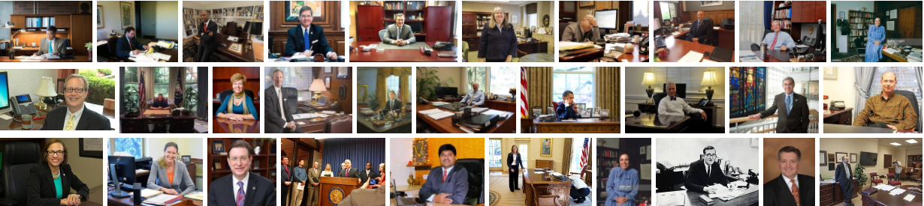
3. Supporting the President/CEO
Presidential Realities
Reality 5. Things look different from the other side of the desk.
Phenomenological absolutism -- Presidents will be privy to many aspects of the campus milieu that influence decisions as much as or more than facts and figures.
Decision making is not fully based on rational factors
James Baldwin (1961), author and civil rights icon, said "the price one pays for pursuing any profession or calling is an intimate knowledge of its ugly side"
Be glad you do not know some things

Slide 19
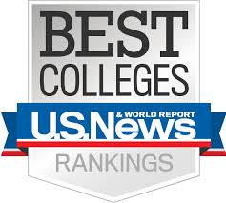
4. Supporting the VPs, Departments and Faculty
Types of Information
Fact books/ Standard Reports
Data Dashboards
Trends
Surveys
Planning, Budget and Finance
Converting Management Data to Public Relations Information
Ad hoc
Responding to Board of Trustees Members
Information Timelines
Necessary, but banal
Focused, has impact
Bling, bling
Dangerous
– do well
Dangerous
– avoid
Helps sanity

Slide 20


5. Do your research as if everyone will read it.
Brain Gain: Rationale, Formula, Progress
Data reality is like politics, in that its beauty is in the eye of the beholder
Objectiveness does not mean not giving recommendations
Provide external context and reference: use standard measures, compare to peers
Don’t throw shade unless shade needs to be thrown
The data should be the star

Slide 21

6. Working with others
Dress the part
Engage professionally
  Send campus leaders links to national studies or significant research that they may be interested in
  Summarize specific reports in a format that they can share with their staff
  Suggest solutions
  Meet with departments to learn more about their work and issues
Find ways in which you can serve the various departments
  Volunteer to support programs going through accrediting studies or visits
  Volunteer to be staff to important committees or task forces
When confronted with data/reporting issues, assume incompetence, not malevolence

Slide 22
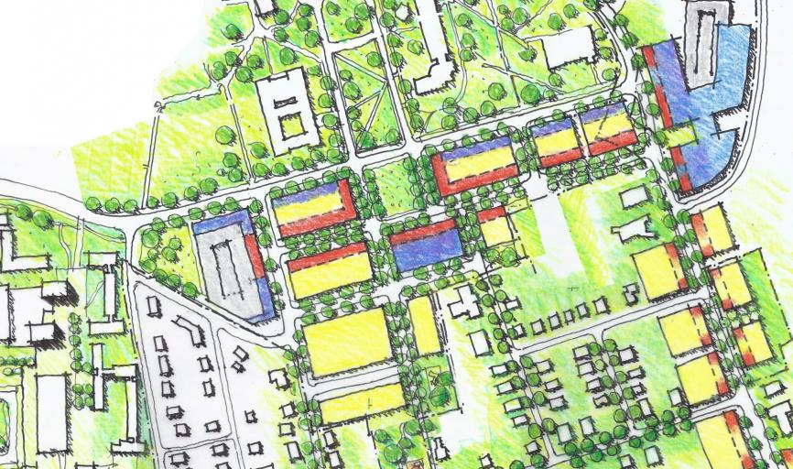

7. Involve yourself in external activities that could change how your institution operates
Efforts to improve data quality (state and federal efforts)
Collaborative research efforts between campuses
State longitudinal databases
Local and state efforts that are not totally college-based
  There is much to learn at the point where your organization and the rest of the world meet

Slide 23
8. Involve yourself in external activities that could change YOU
1000 weekends (40 X 25)
Use your talents in other places of importance.
Do things that grow your skill set
Set yourself up for opportunities for growth
These things will make you a better researcher and a better person

Slide 24
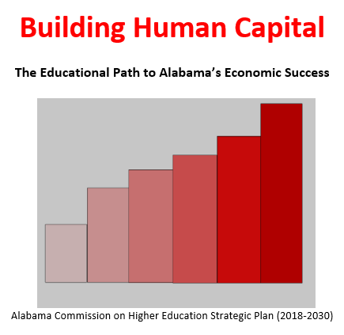
Jim Purcell, Ed.D., Executive Director, Alabama Commission on Higher Education

Slide 25
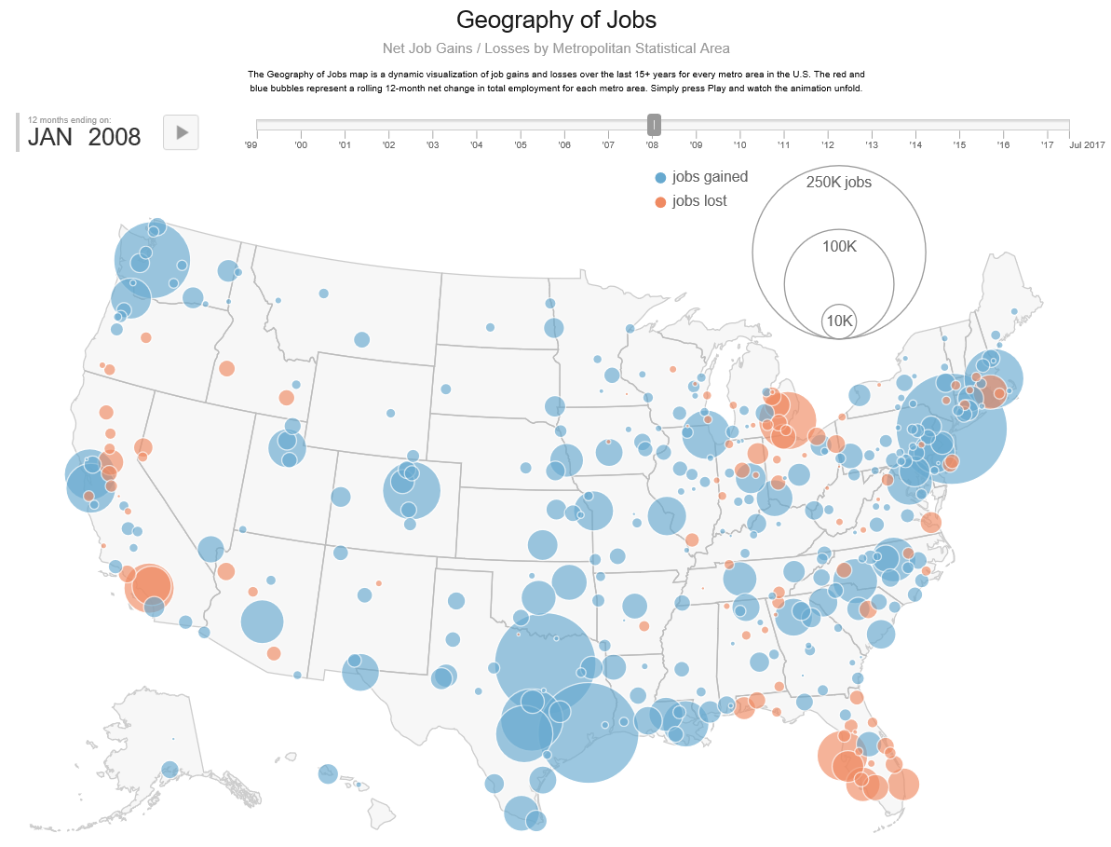

Slide 26
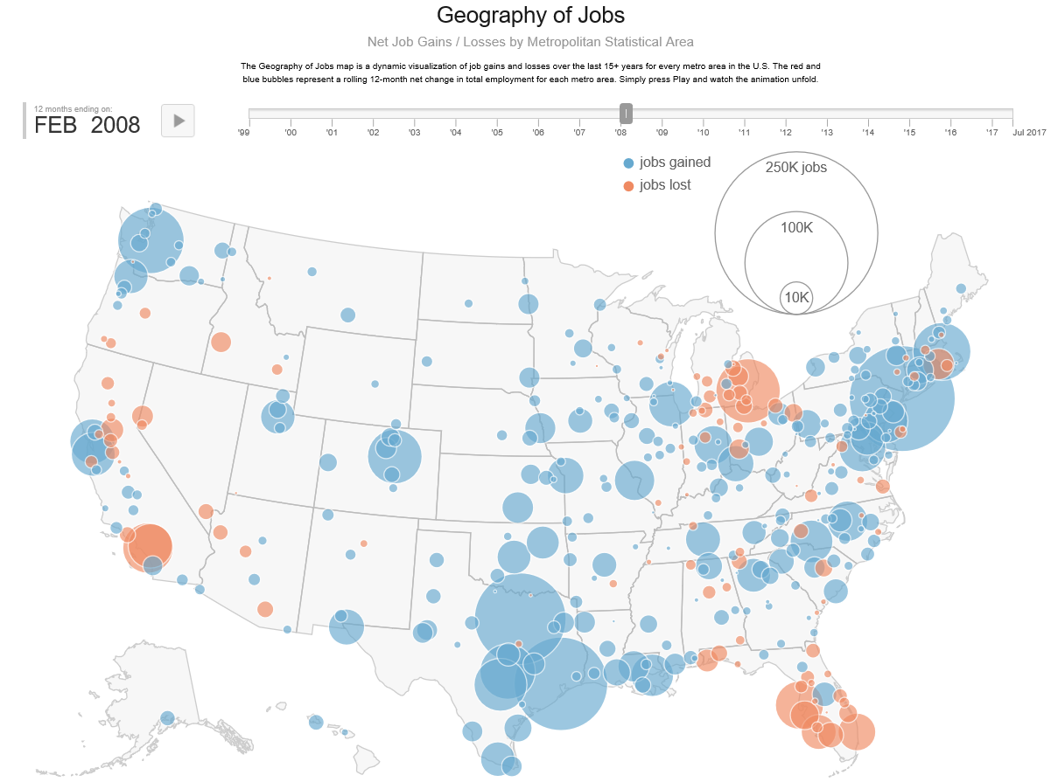

Slide 27
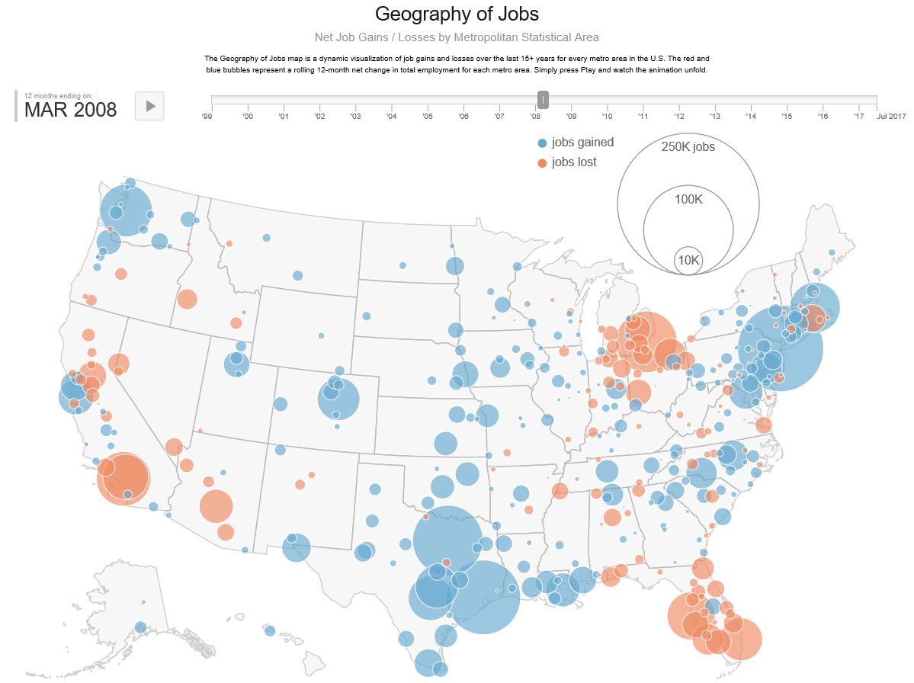

Slide 28
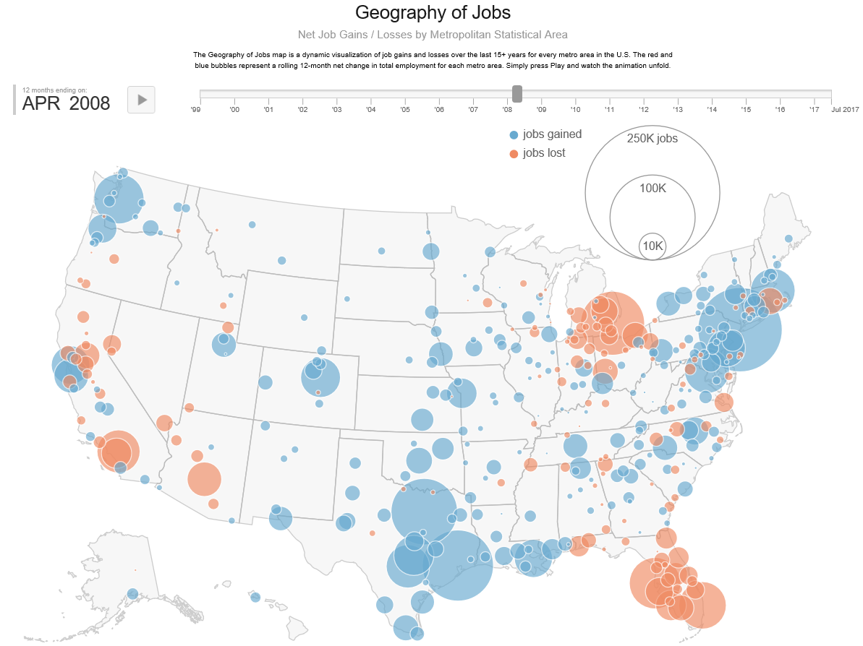

Slide 29
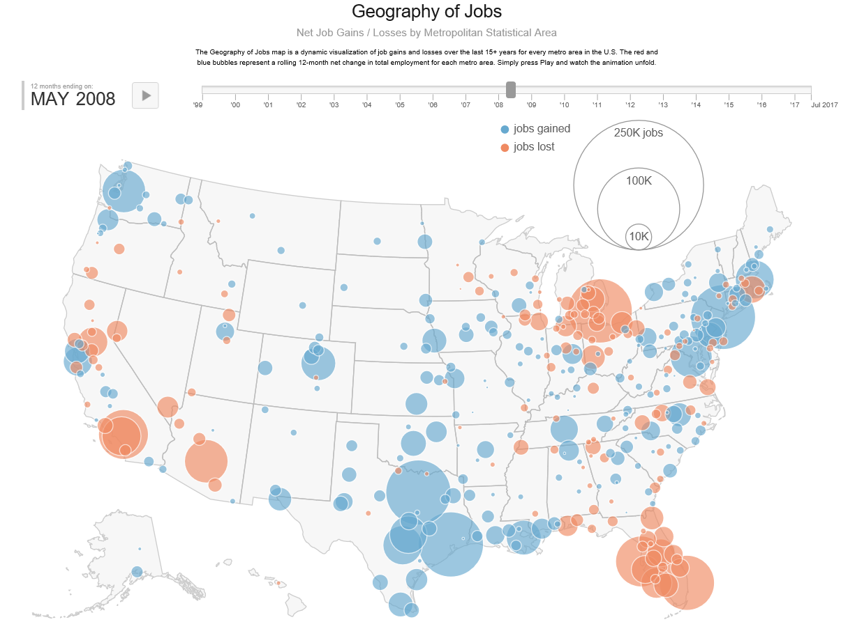

Slide 30
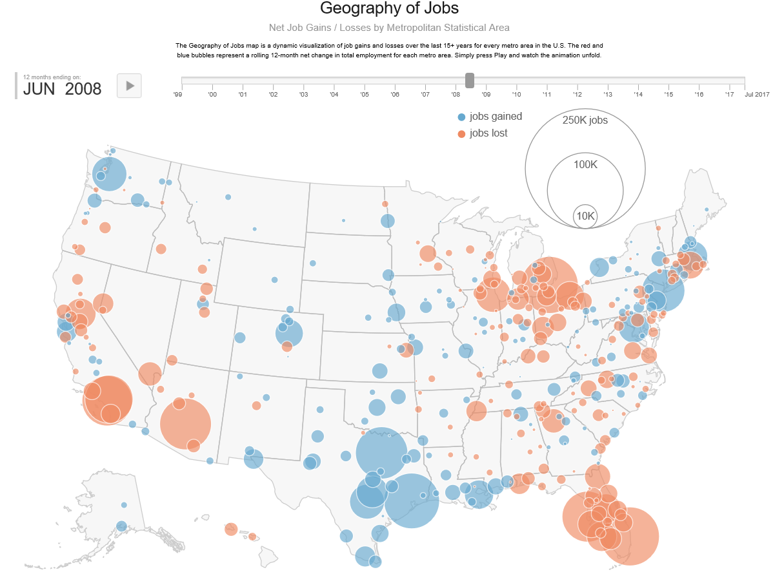

Slide 31
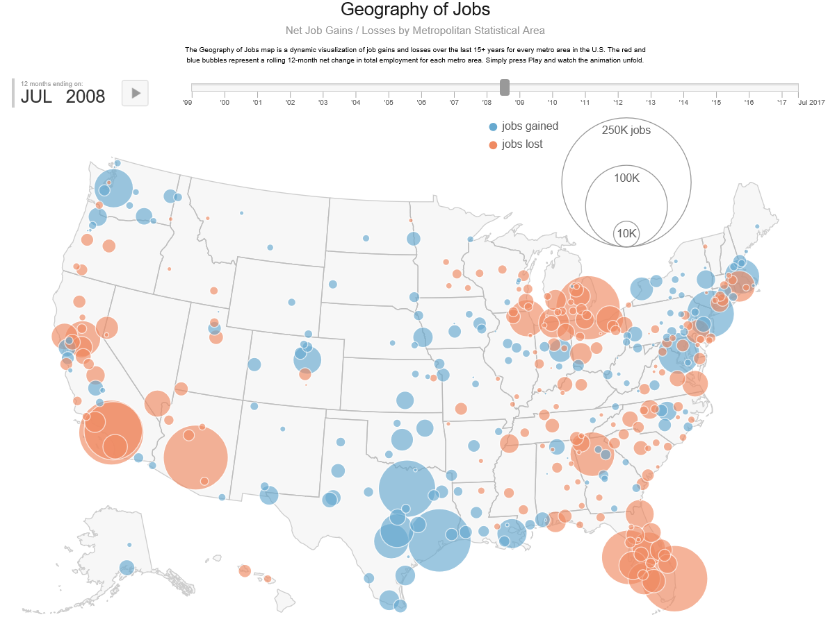

Slide 32
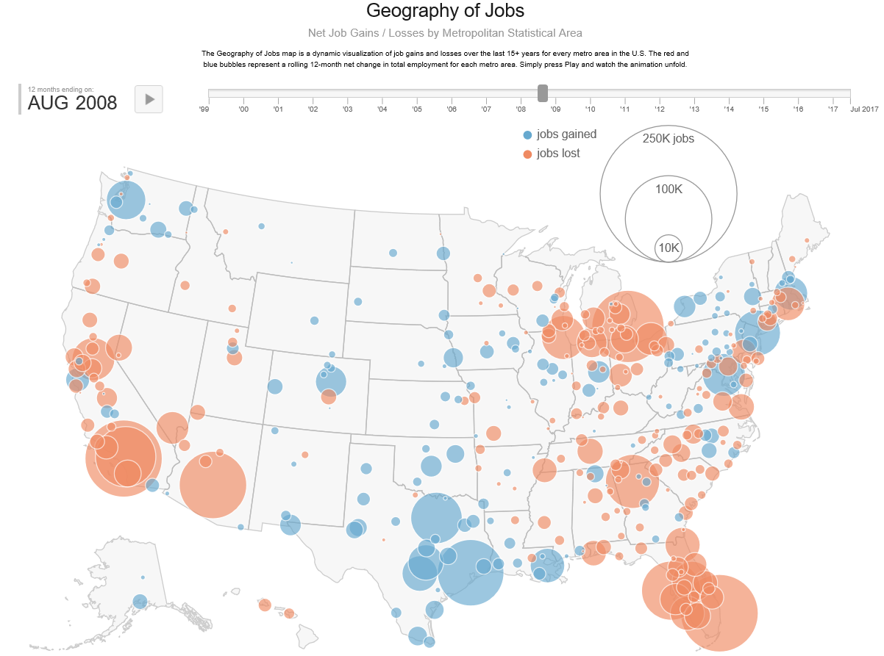

Slide 33
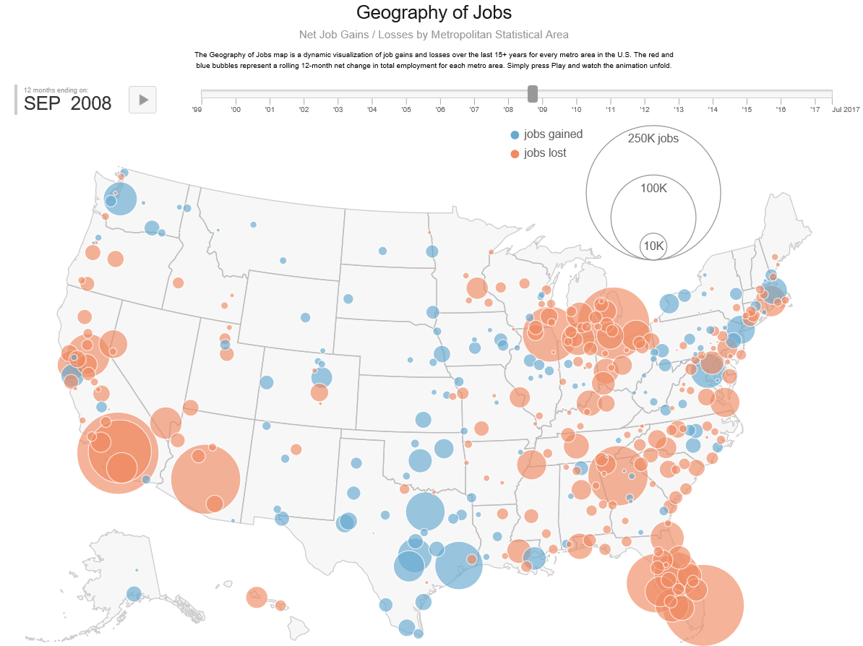

Slide 34


Slide 35
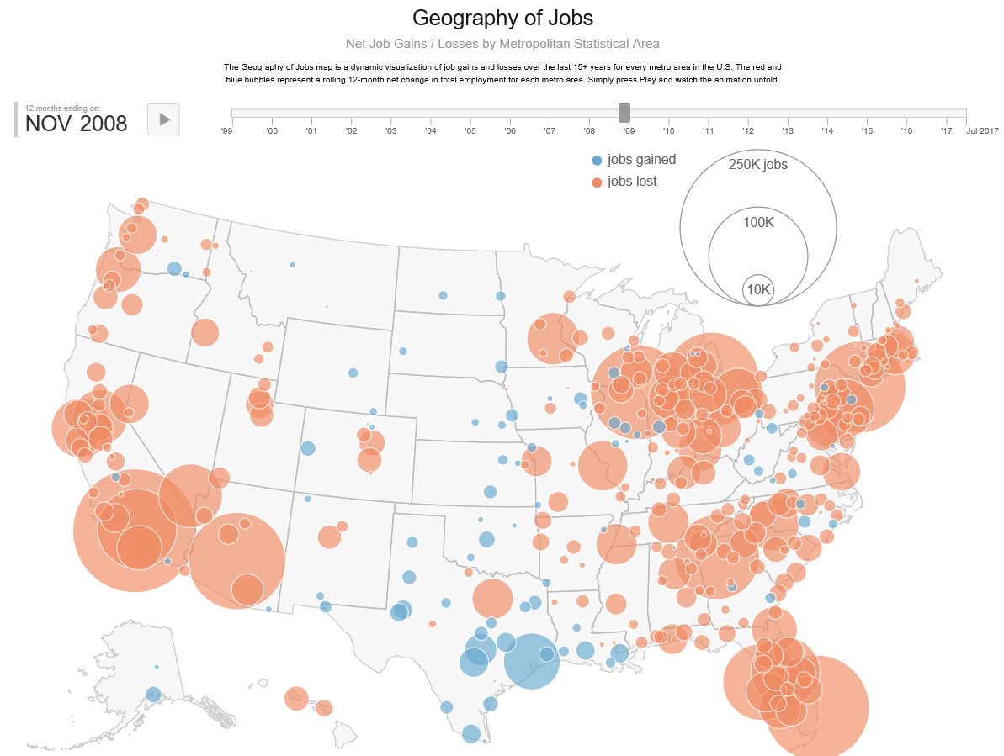

Slide 36
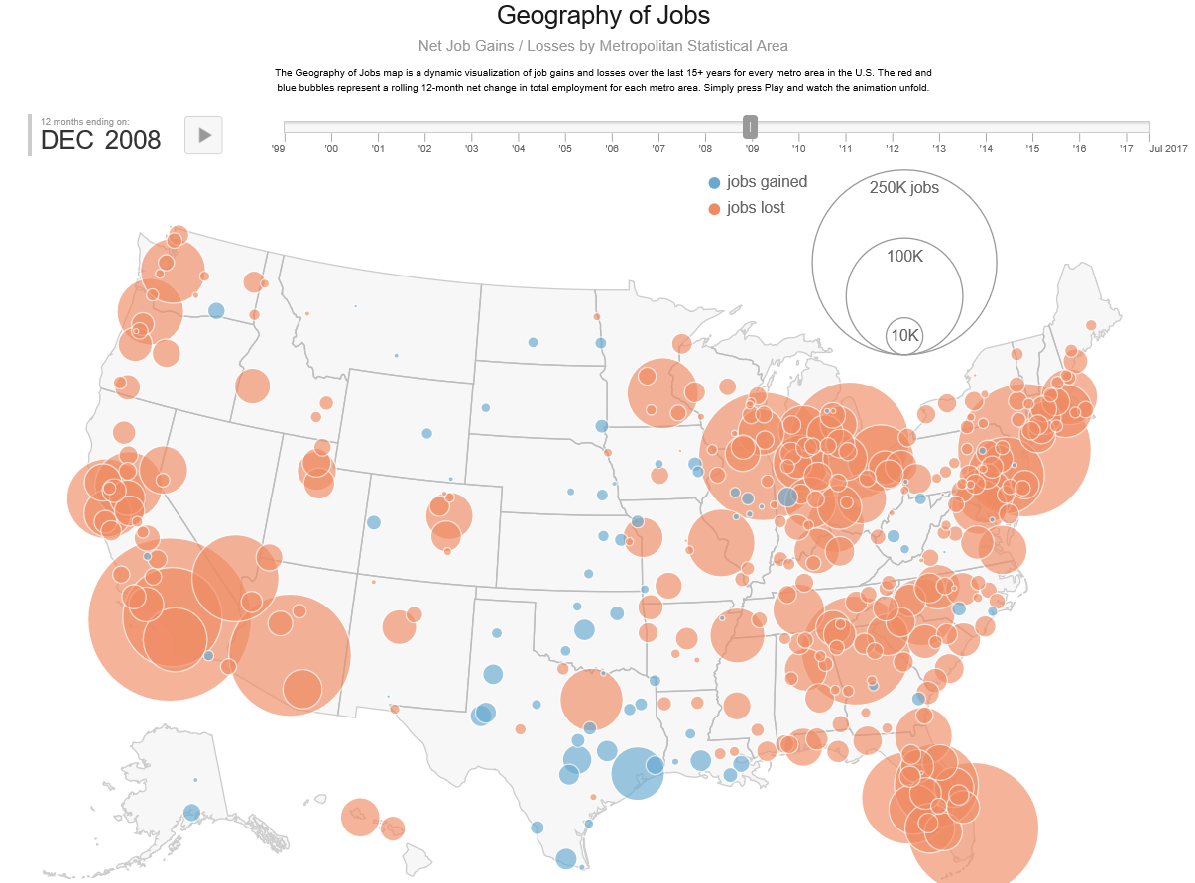

Slide 37
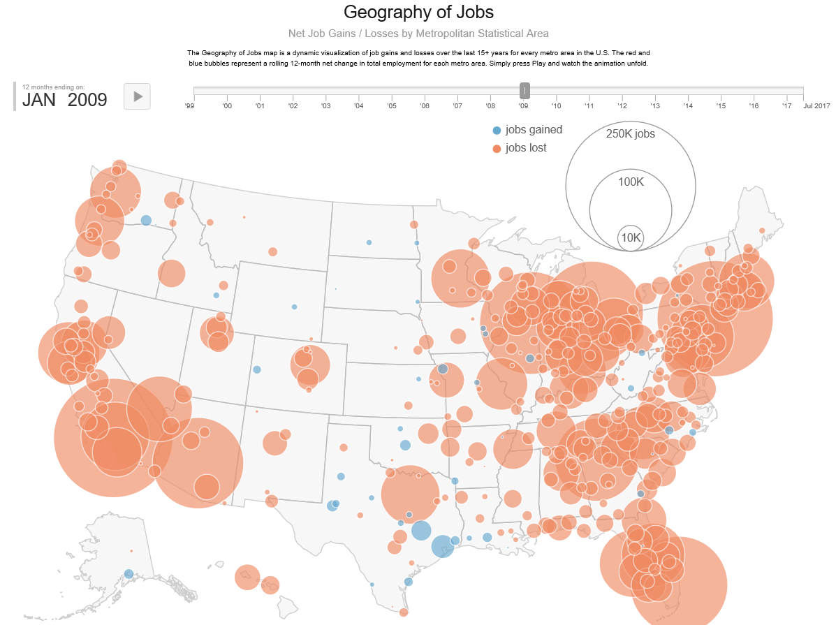

Slide 38
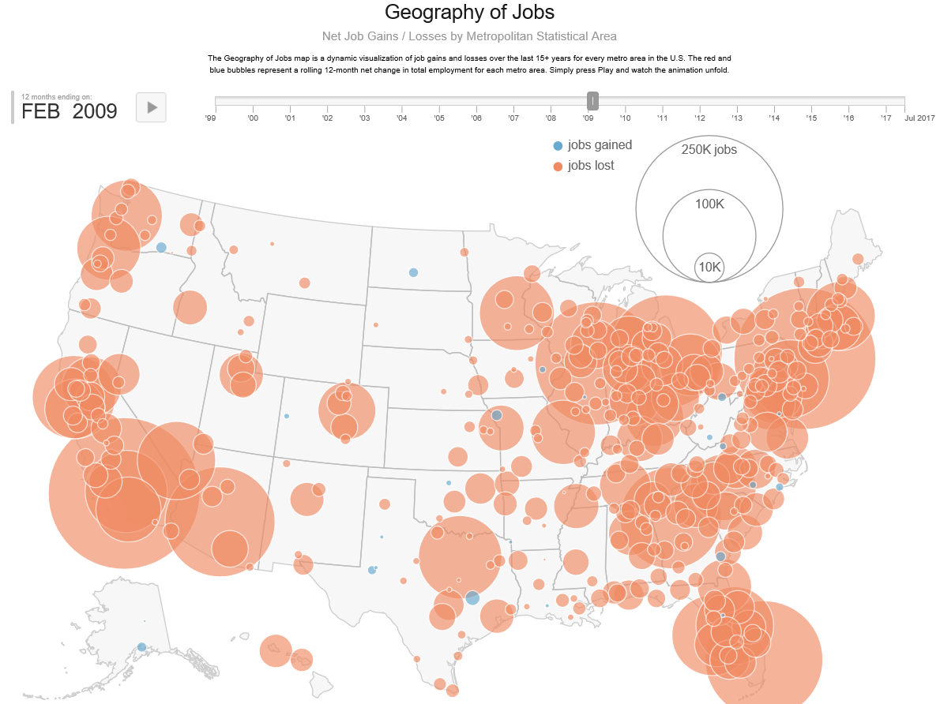

Slide 39
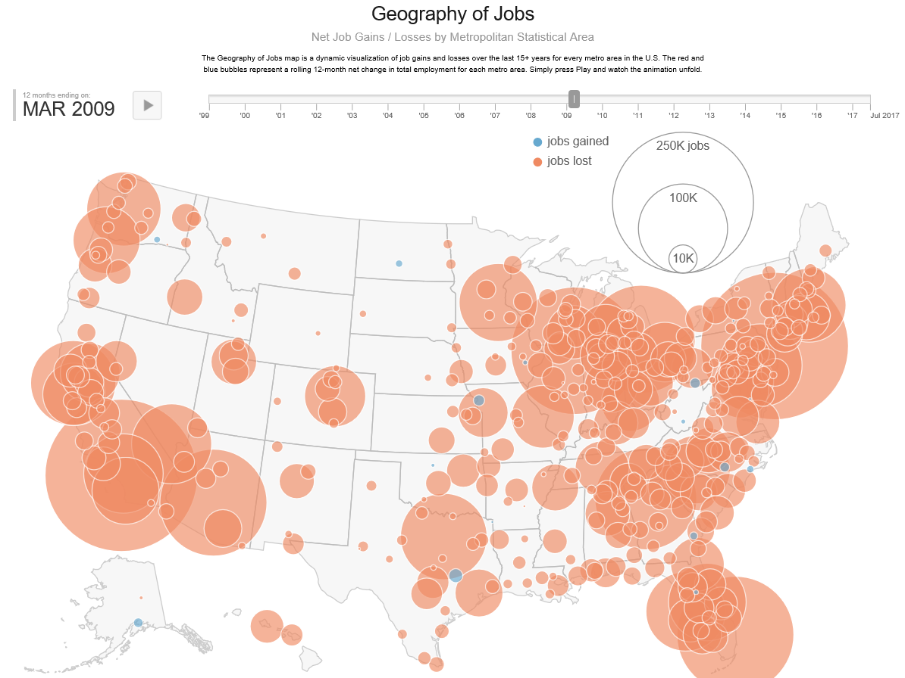

Slide 40
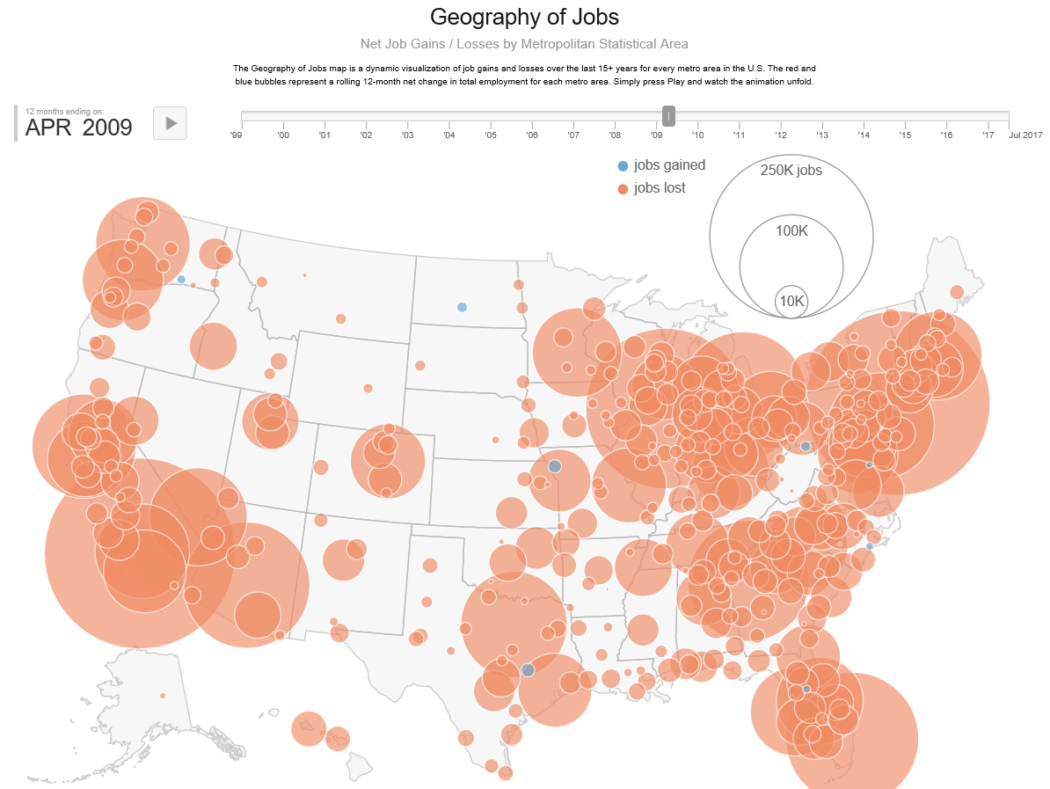

Slide 41
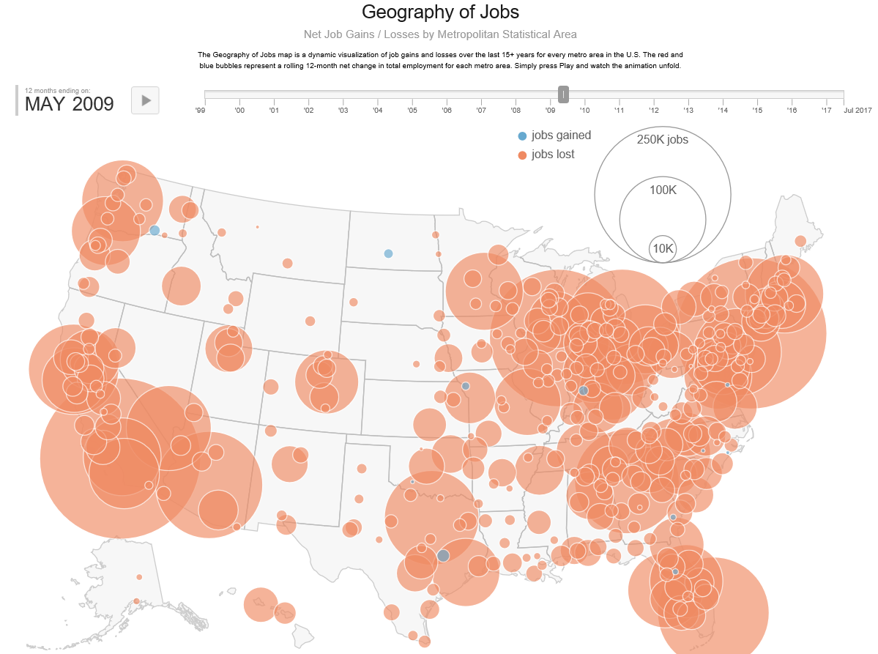

Slide 42
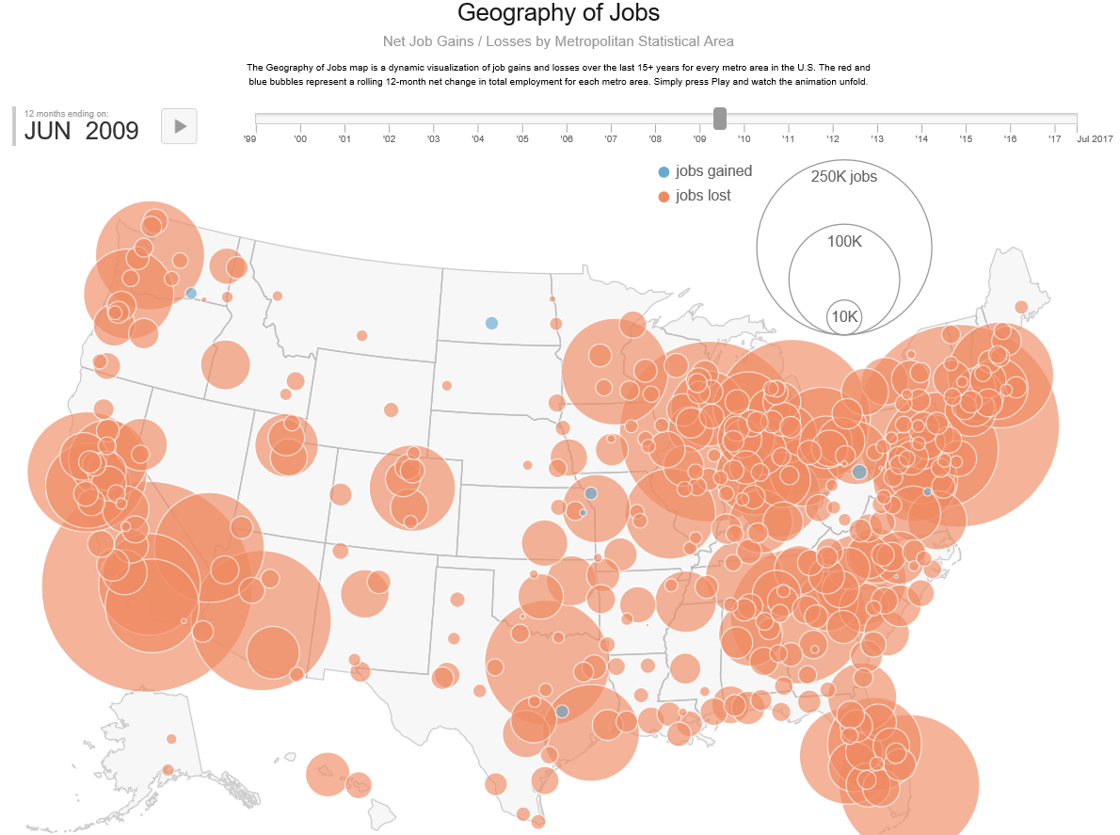

Slide 43
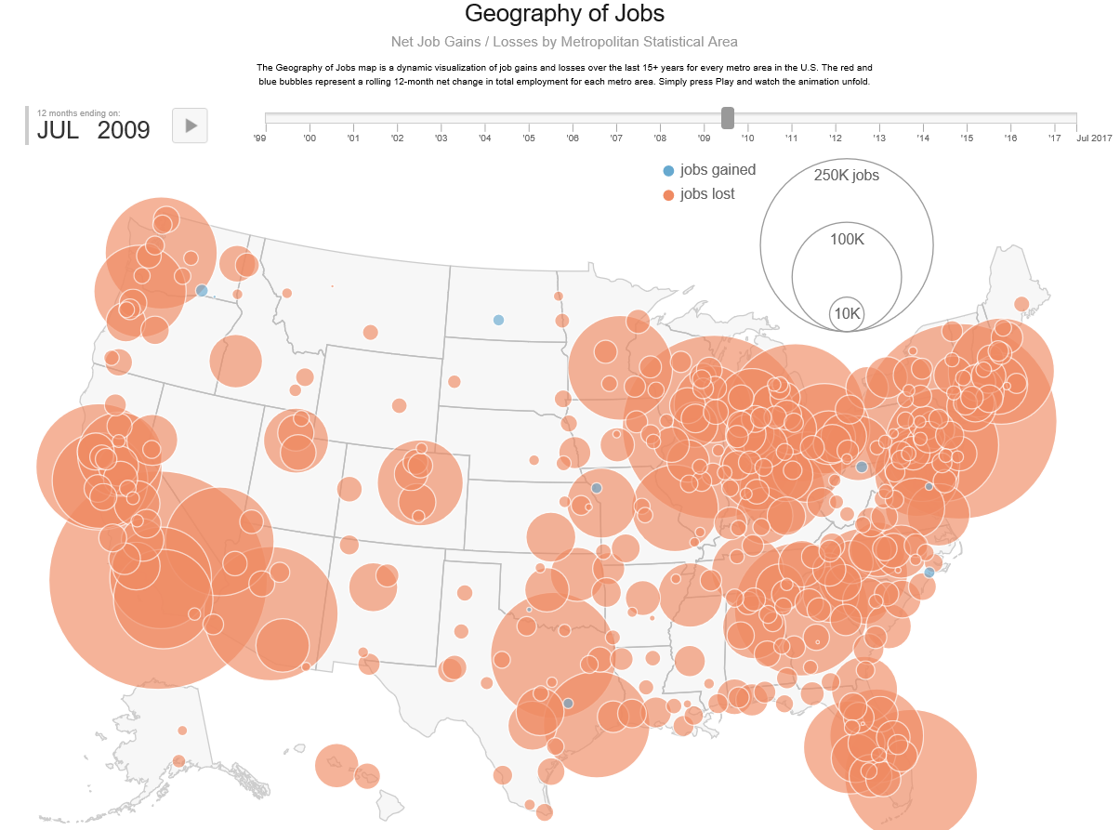

Slide 44


Slide 45
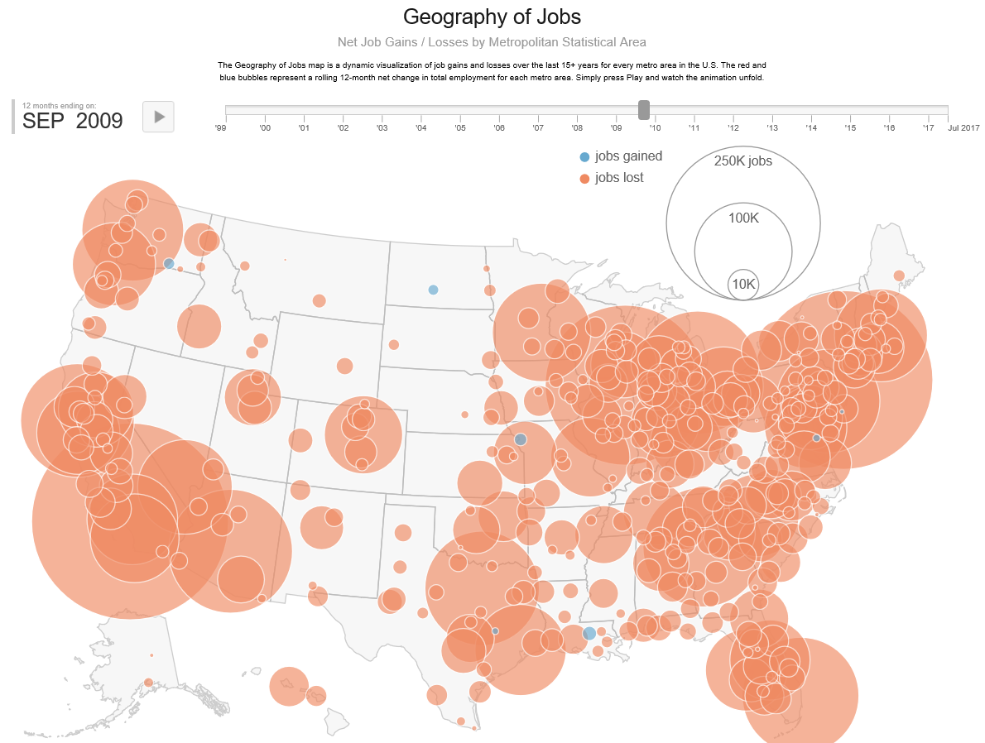

Slide 46
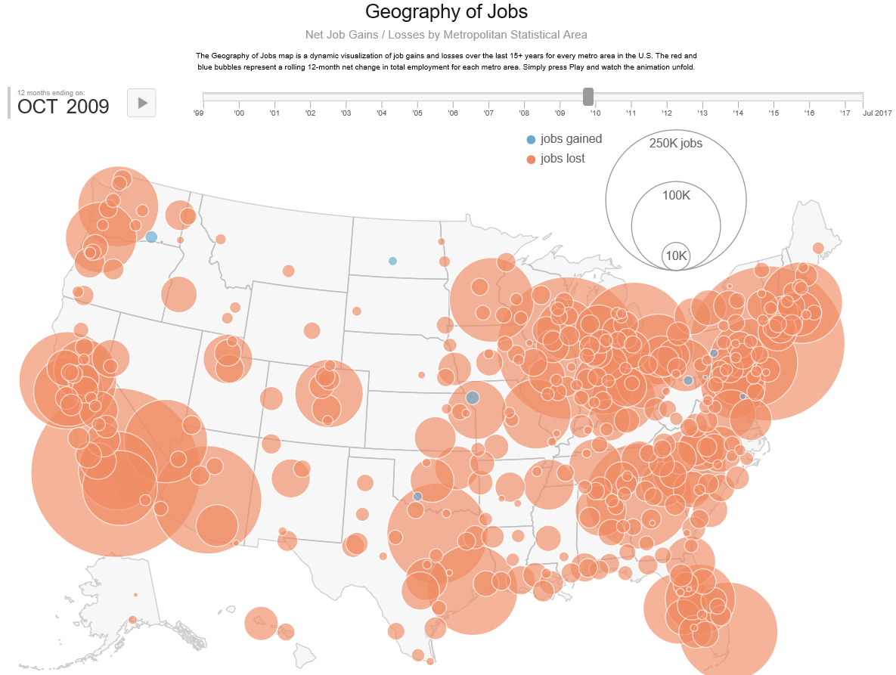

Slide 47
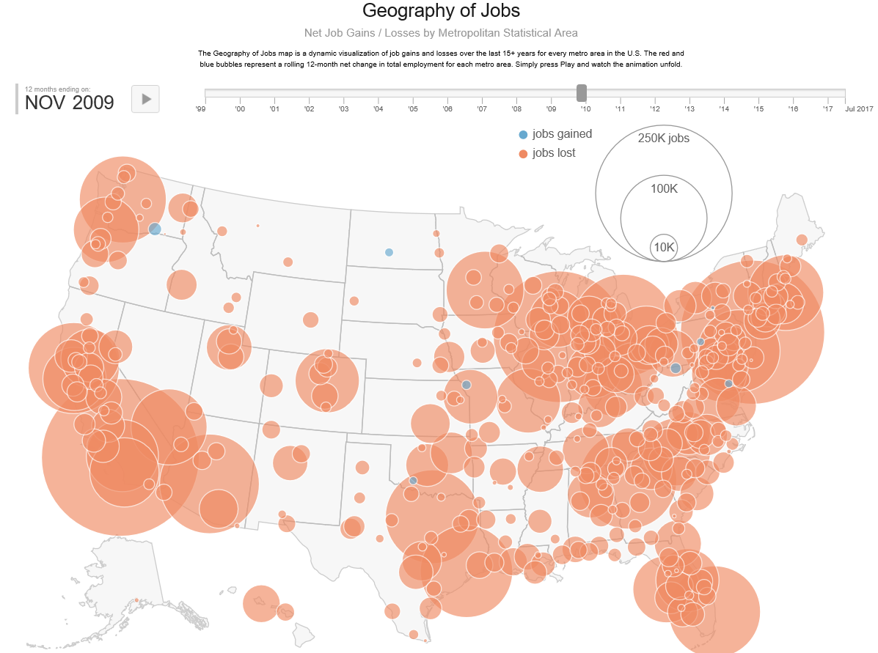

Slide 48


Slide 49
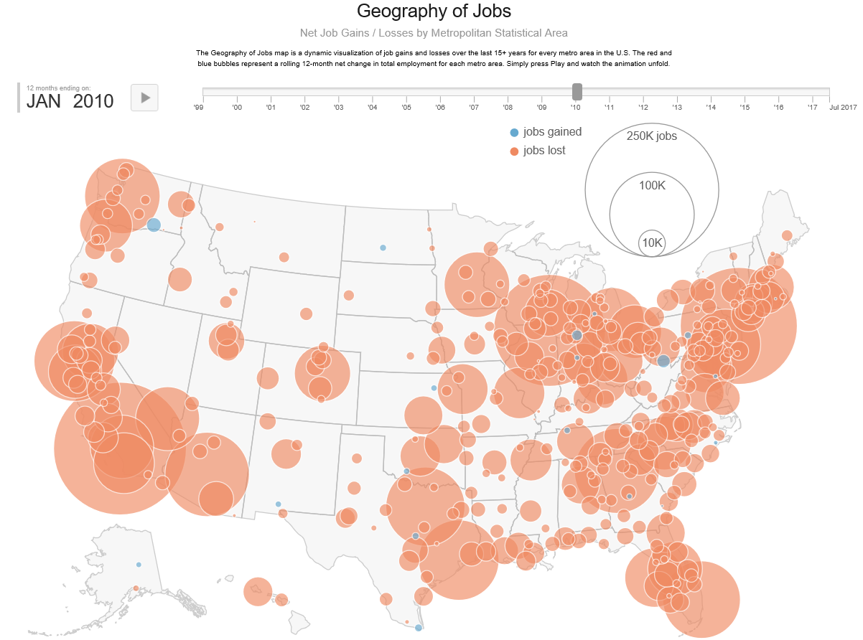

Slide 50
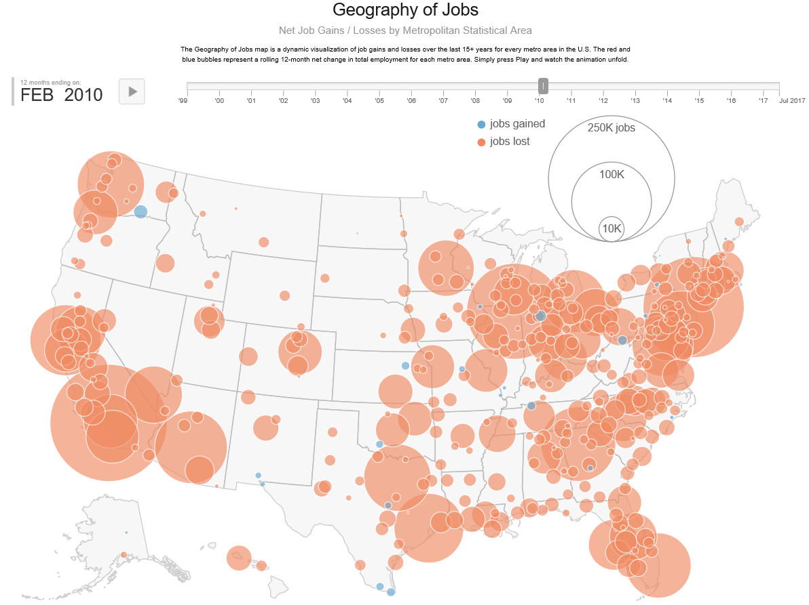

Slide 51
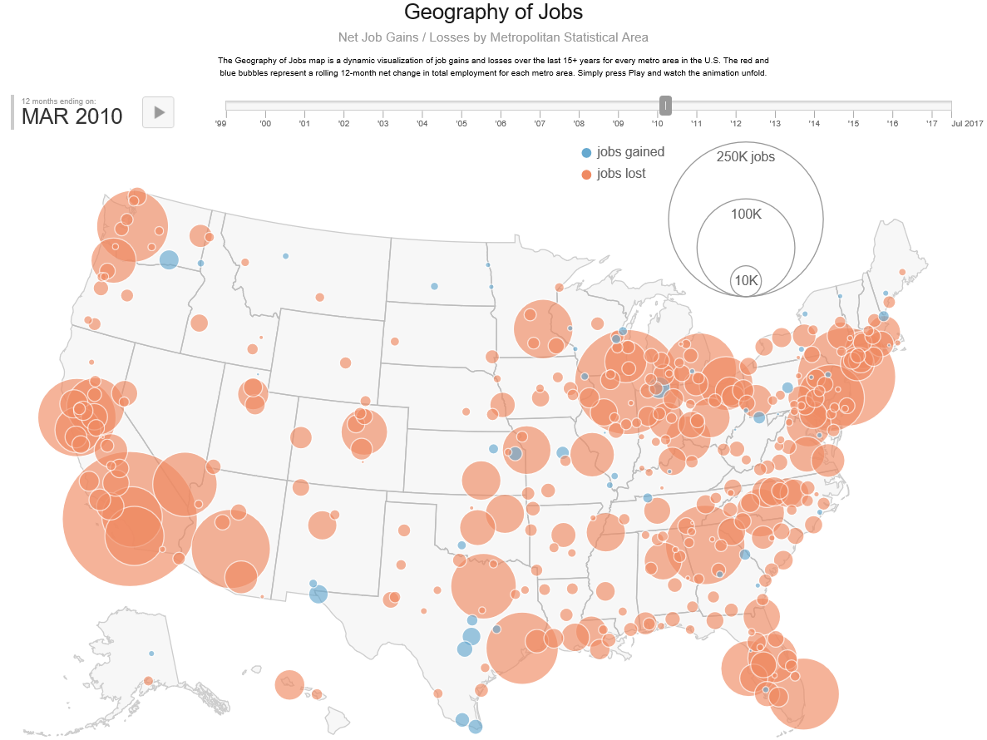

Slide 52
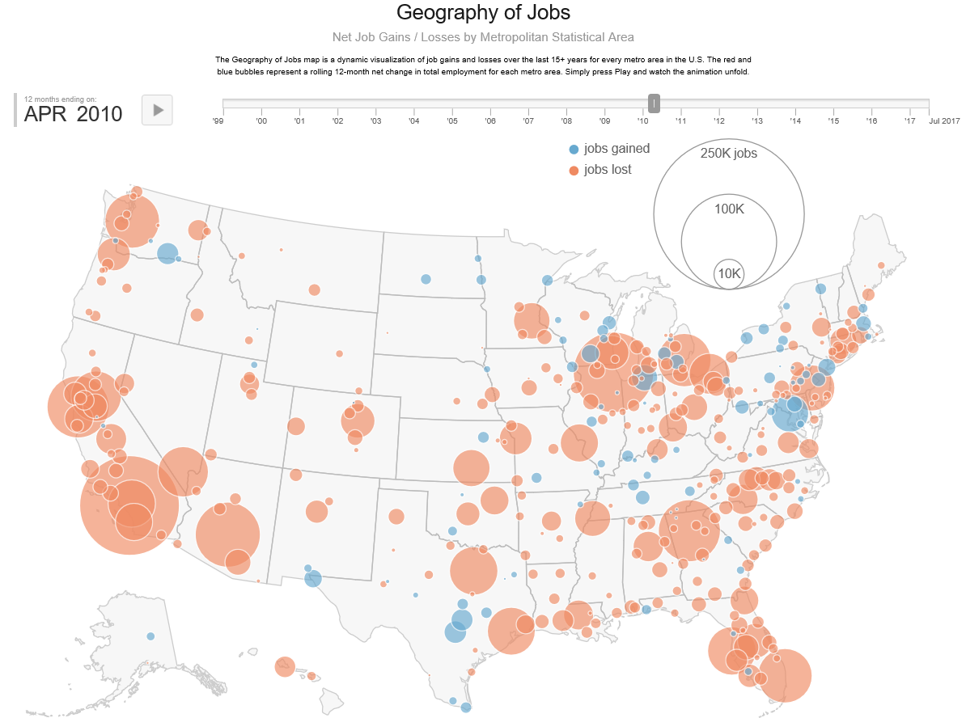

Slide 53
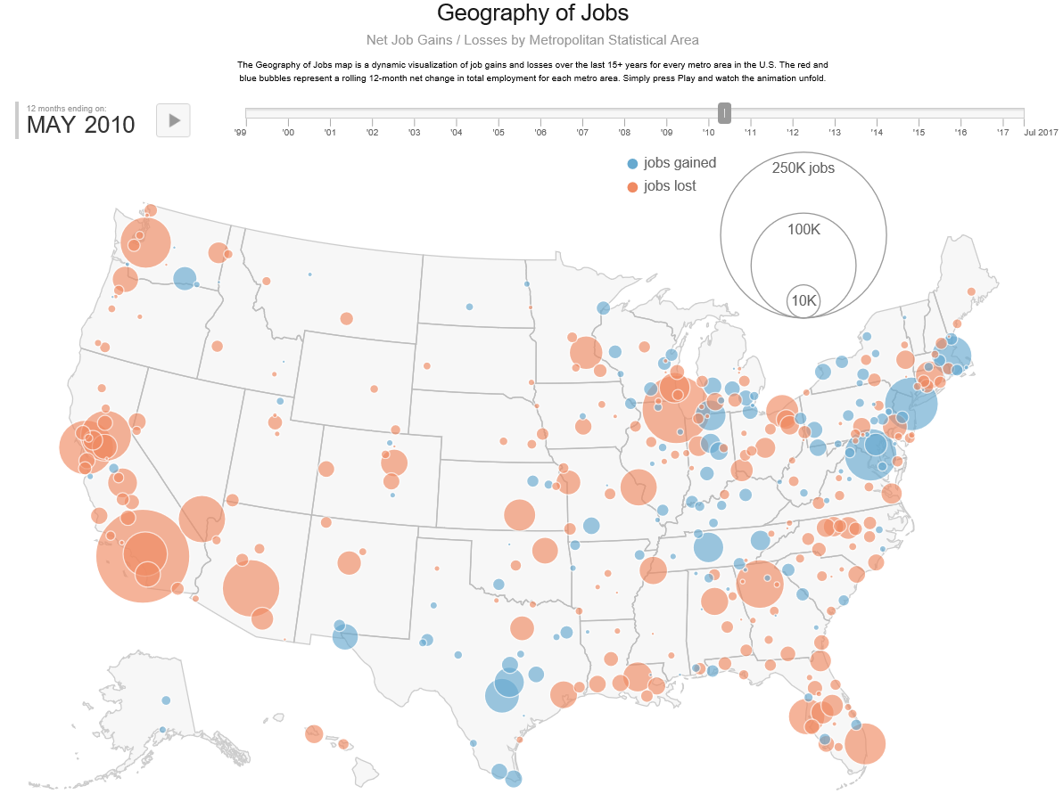

Slide 54
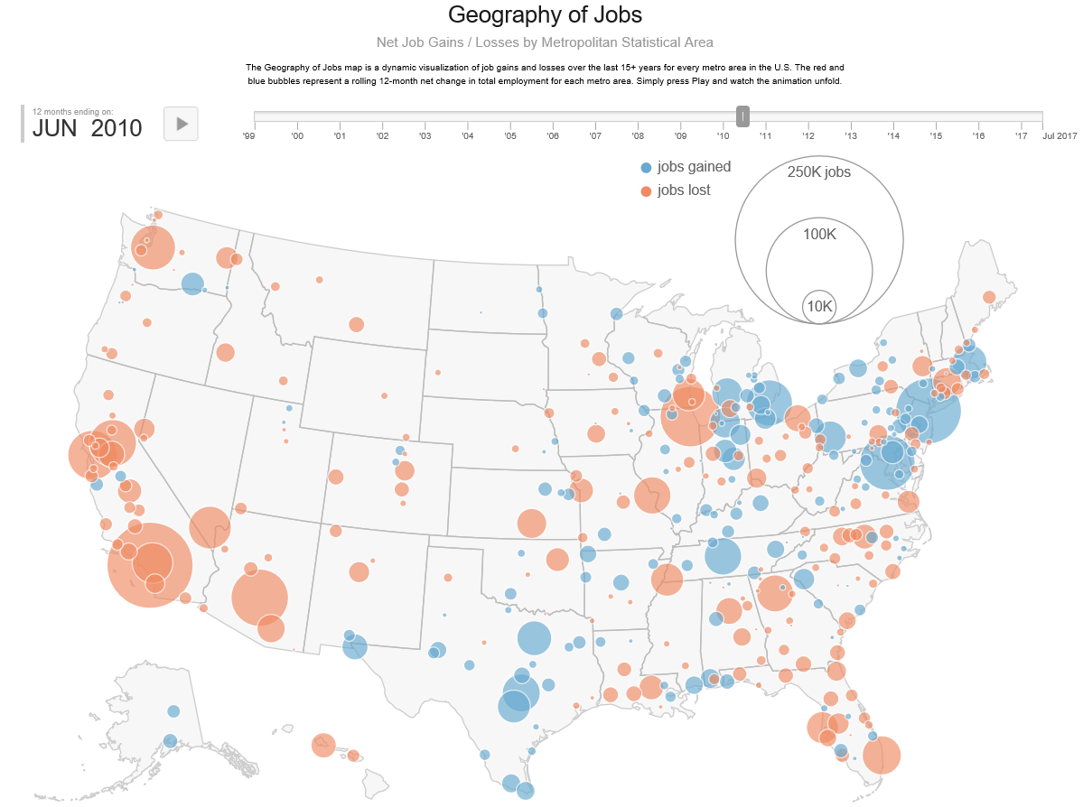

Slide 55
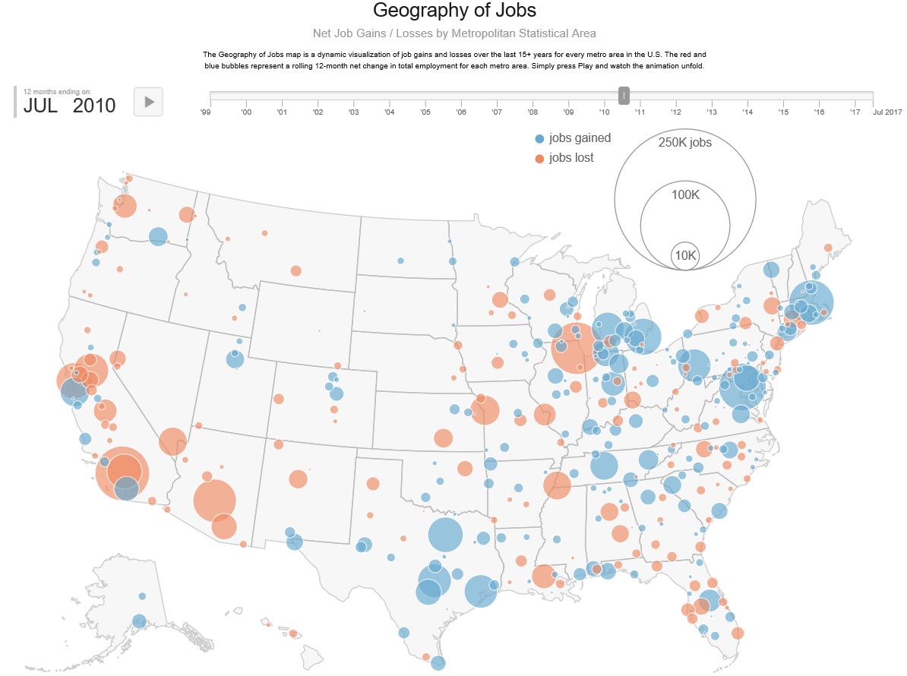

Slide 56
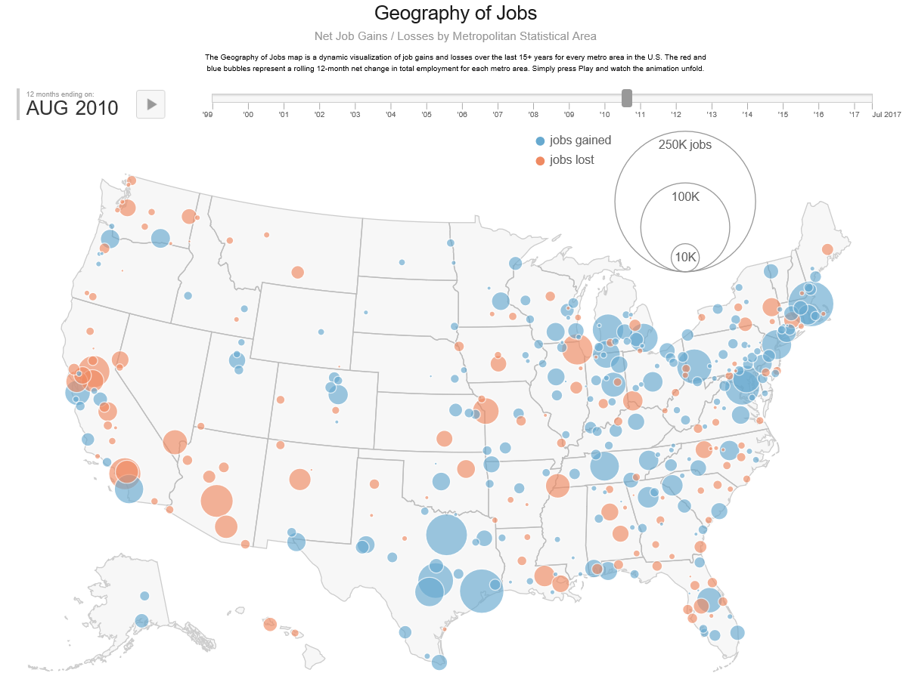

Slide 57
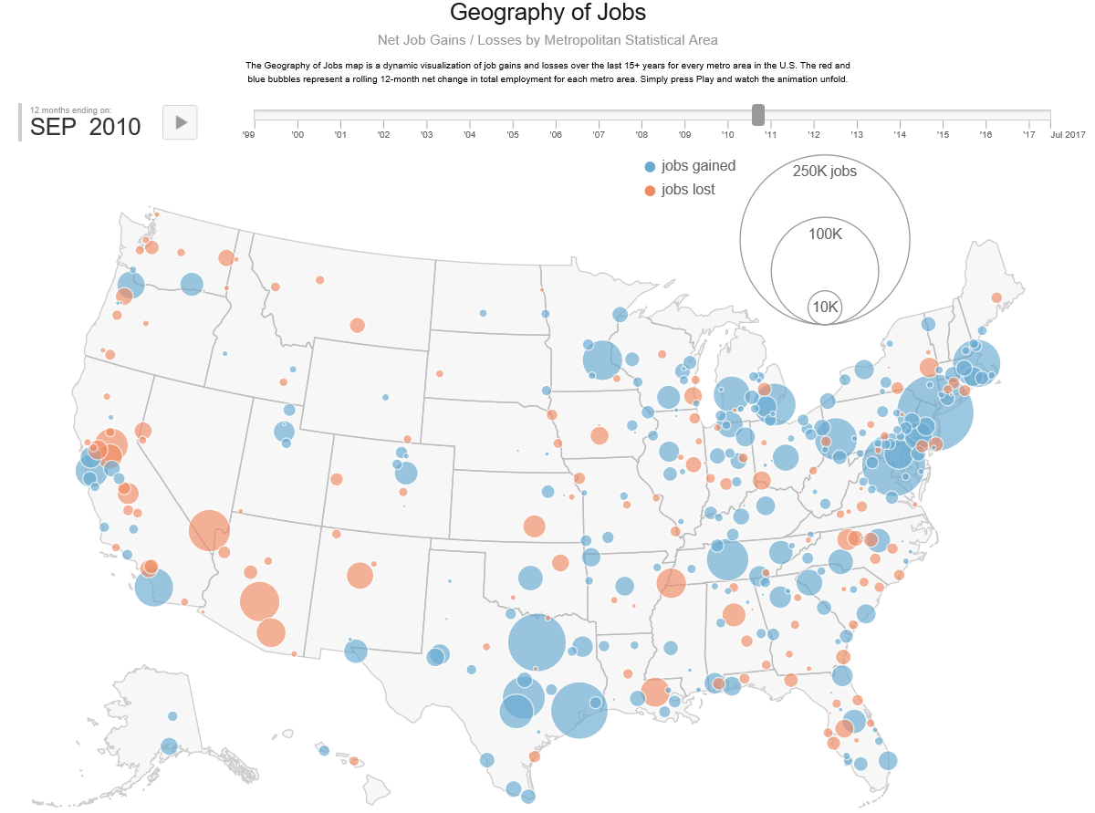

Slide 58
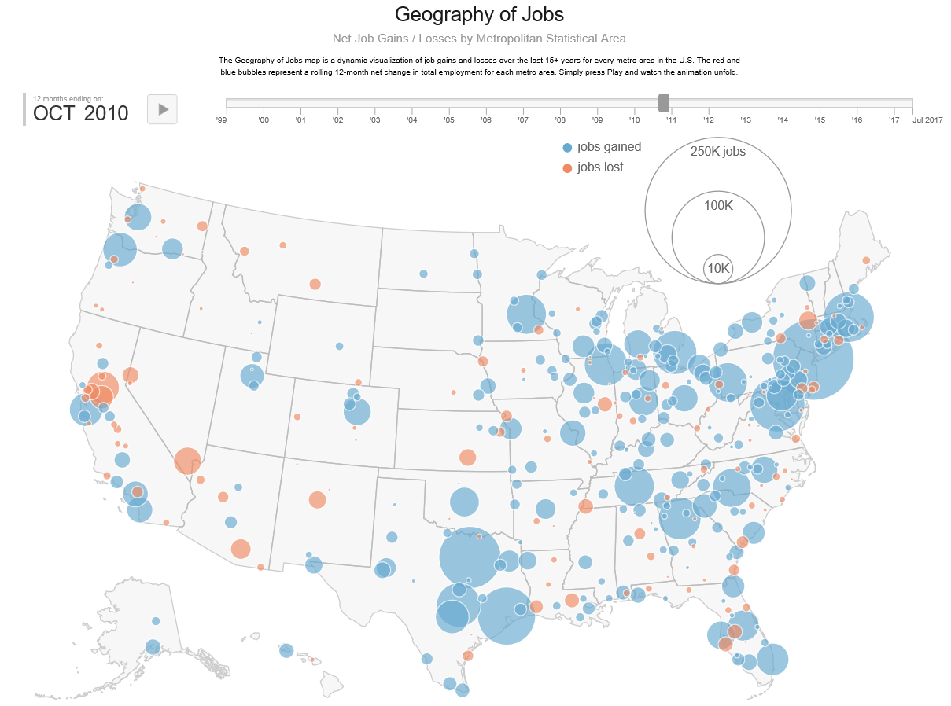

Slide 59
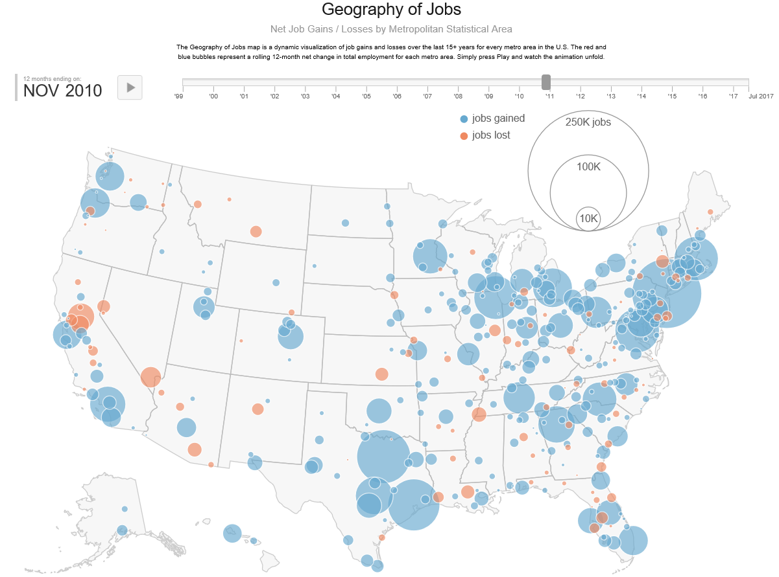

Slide 60
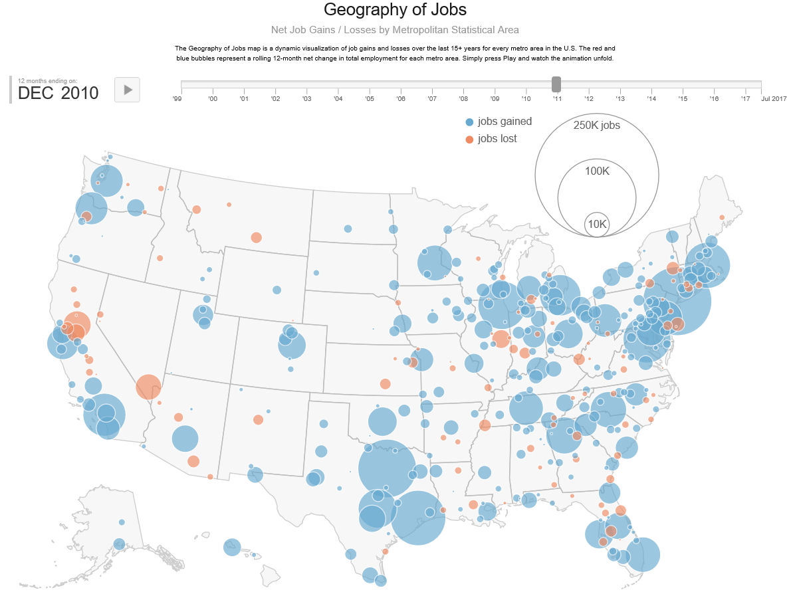

Slide 61
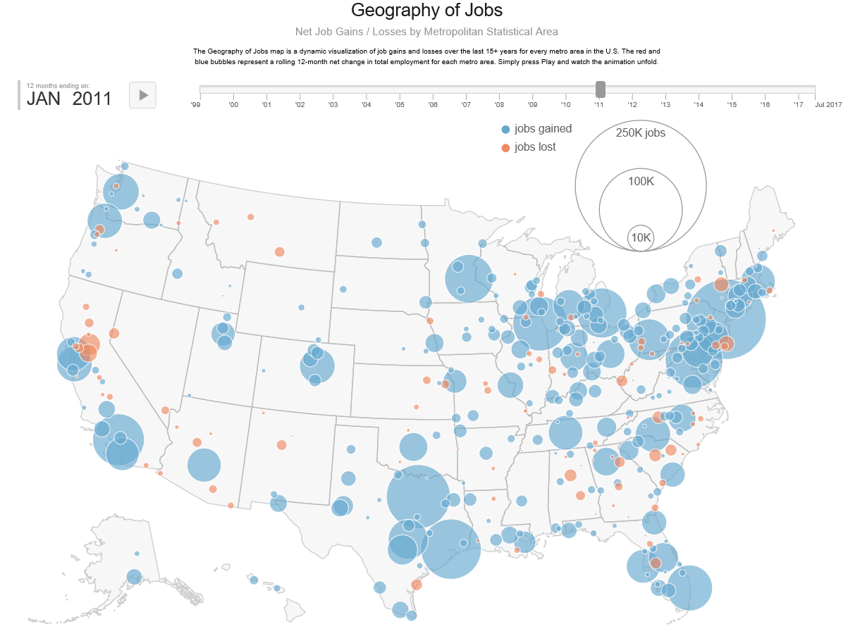

Slide 62
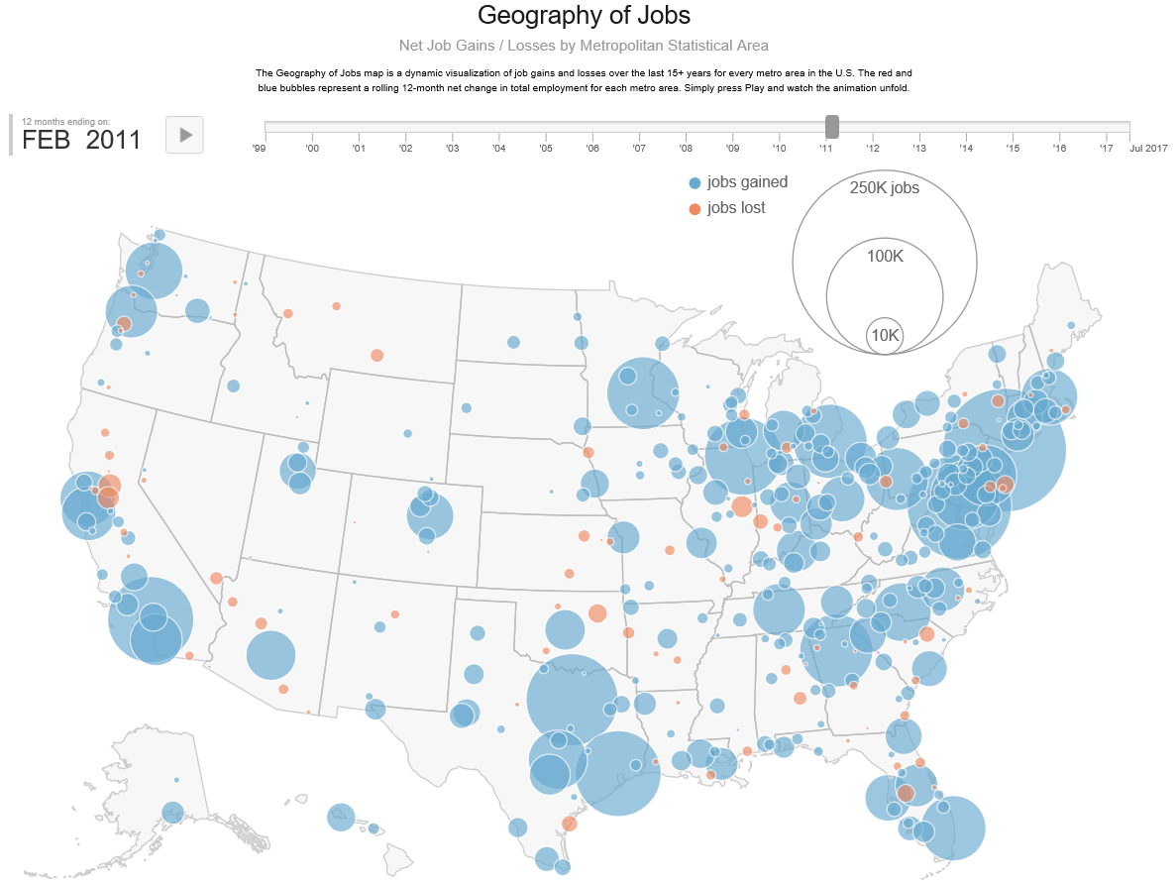

Slide 63


Slide 64
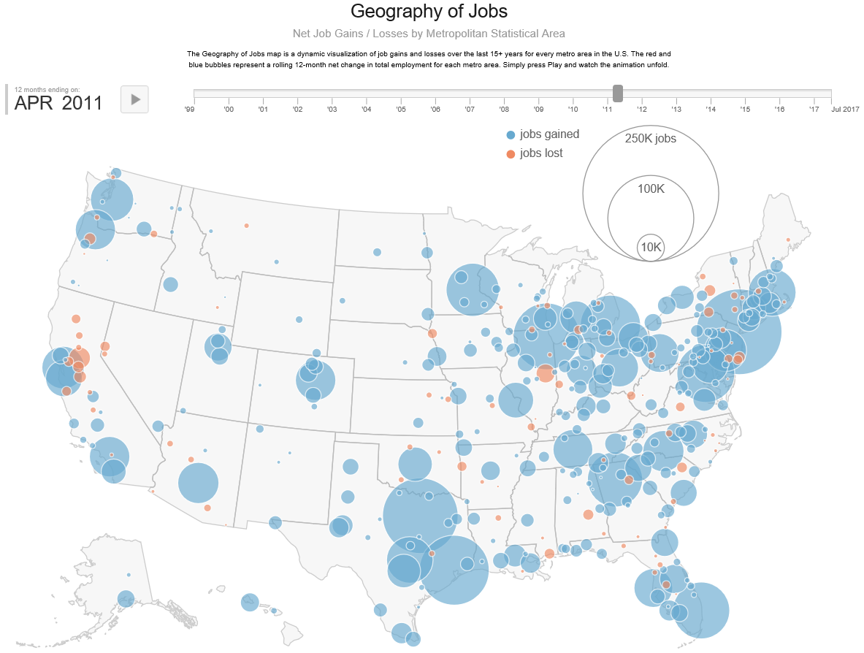

Slide 65
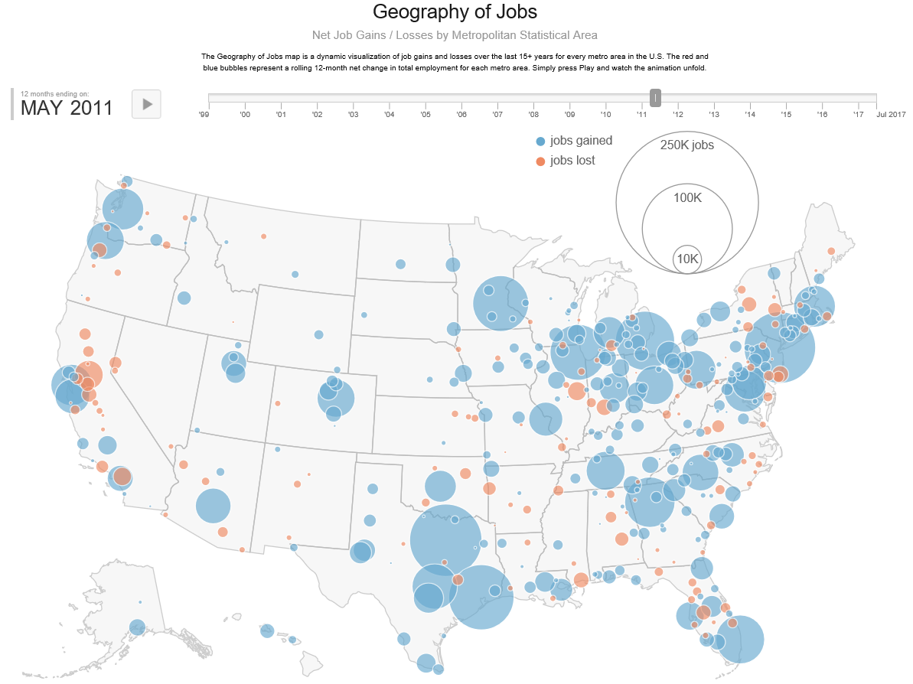

Slide 66
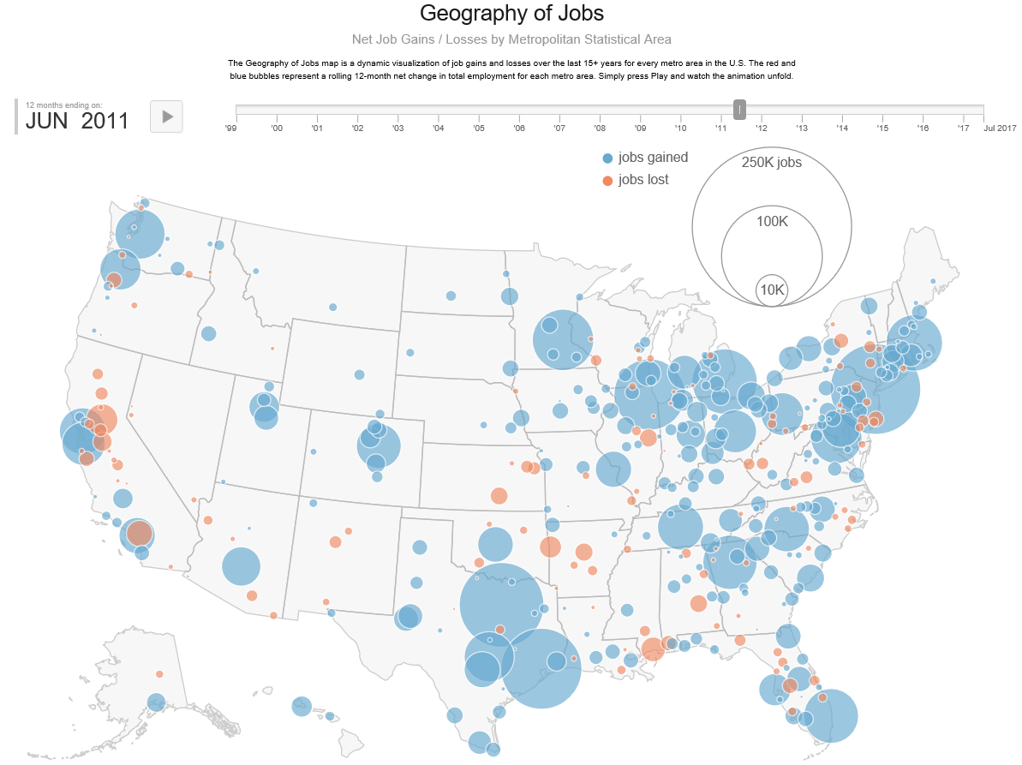

Slide 67
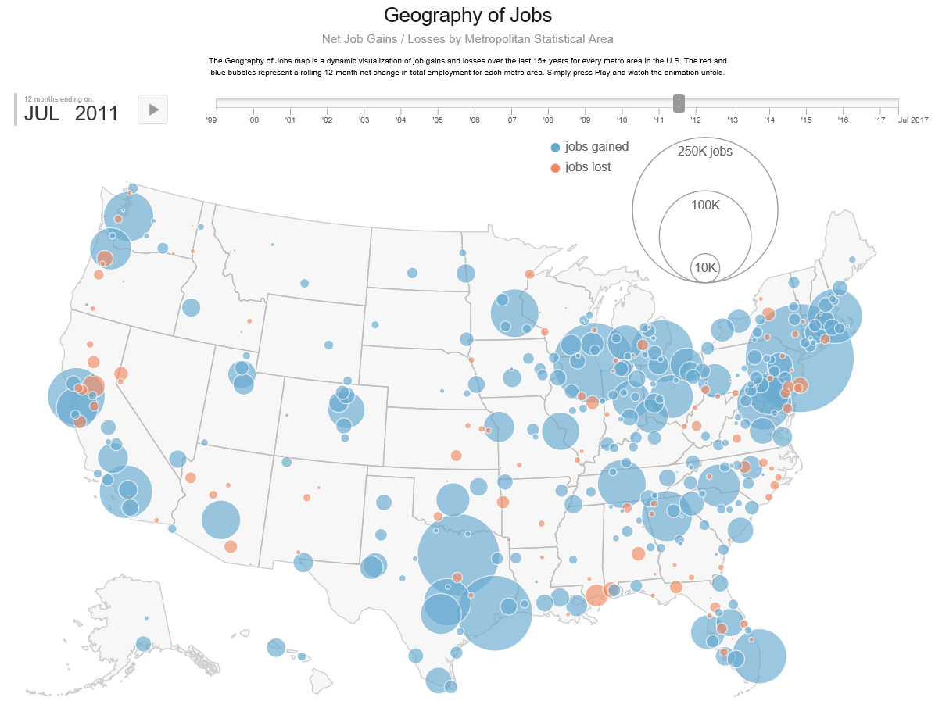

Slide 68
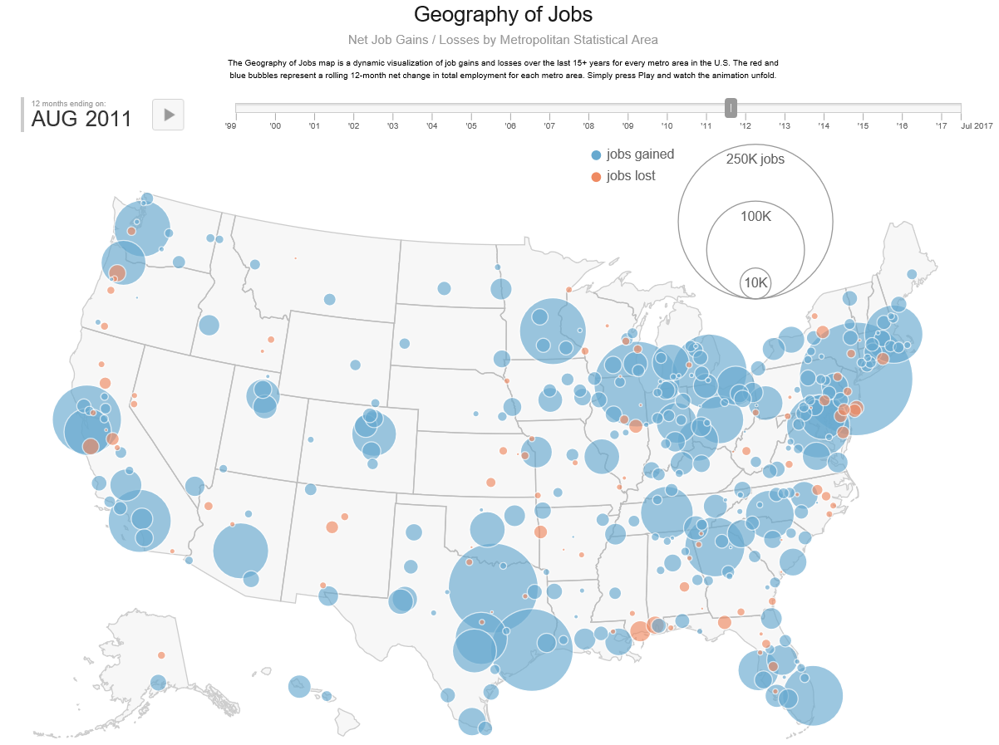

Slide 69
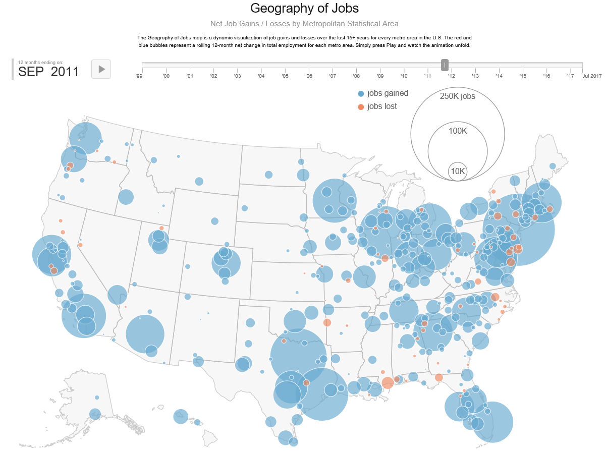

Slide 70
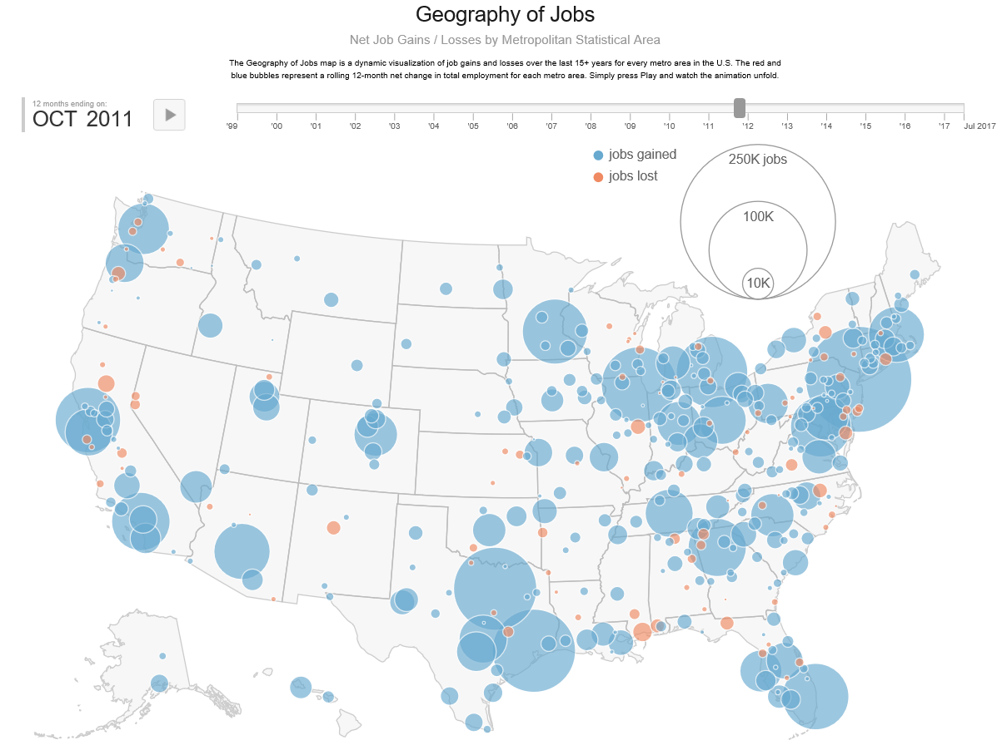

Slide 71


Slide 72


Slide 73


Slide 74


Slide 75


Slide 76


Slide 77


Slide 78


Slide 79


Slide 80


Slide 81


Slide 82


Slide 83


Slide 84


Slide 85


Slide 86


Slide 87


Slide 88


Slide 89


Slide 90


Slide 91


Slide 92


Slide 93


Slide 94


Slide 95


Slide 96


Slide 97


Slide 98


Slide 99


Slide 100


Slide 101


Slide 102


Slide 103


Slide 104


Slide 105


Slide 106


Slide 107


Slide 108


Slide 109


Slide 110


Slide 111


Slide 112


Slide 113


Slide 114


Slide 115


Slide 116


Slide 117


Slide 118


Slide 119


Slide 120


Slide 121


Slide 122


Slide 123


Slide 124


Slide 125


Slide 126


Slide 127


Slide 128


Slide 129


Slide 130


Slide 131


Slide 132


Slide 133


Slide 134


Slide 135


Slide 136


Slide 137


Slide 138


Slide 139


Slide 140

Good news:
Employers are hiring
Bad news:
Not all employers can find the skilled workers they need. Experts say that such a high number of job openings is due partially to a gap between the job skills employers demand and the skills job seekers have.
skills gap … is holding down overall wage growth in the US

Slide 141


201260%
58%
It takes two incomes to sustain households today
35%
196025%
How Technology Is Destroying Jobs
By David Rotman

Slide 142




Slide 143


Density of educated/ skilled workers
Access to good schools, colleges, universities
Local leadership
Regional economic development strategies rather than state-wide strategies
Return to city-states
  Sparta and Athens
Work ready communities

Slide 144



Slide 145

Education
Futurists say that communities with higher levels of educated citizens have the potential of becoming the ‘engines’ that drive a state’s economy—if driven by energetic and innovative leaders.

Slide 146

Income
Percentage of households receiving Social Security Income
While some counties have higher incomes, retiree income does not produce GDP.
GDP excludes nonproduction transactions: public transfer payments, such as Social Security, private transfer payment, such as gifts, and financial market.

Slide 147


A Strong Correlation Across
261 Metro Areas
Increase the level of education of a community’s citizenry by 1 year of postsecondary education:
17.4% increase in GDP per capita
17.8% increase in real wages per worker

Slide 148
Alabama Fiscal Support for Higher Education Per $1,000 of Personal Income, 1961-2015
Current state support for our colleges and universities is at the 1967 level!

Slide 149


Slide 150

The repercussion of low state support is higher tuition.

Slide 151
State general funding per student is still lower than 2008 levels in 46 states. The chart shows the percent change in state formula funding per student, inflation adjusted, for fiscal years 2008-2017.

Slide 152

-82.74 decrease in need-based aid
During the same time period tuition increased 27%

Slide 153

There is some urgency for credential production
The current educational requirements of the occupations that may grow are higher than those for the jobs displaced by automation.
If displaced workers are not reemployed quickly, countries will face rising unemployment and depressed wages
Globally, up to 375 million workers may need to switch occupational categories by:
2030

Slide 154
166 Million
One-third of the global occupational change will be in the US.
Alabama can be proactive and position itself to prosper during this dramatic economic transition by preparing its citizenry.

Slide 155
One-third of the global occupational change will be in the US.

Slide 156


Slide 157


WAGE POLARIZATION MAY CONTINUE IN SOME ADVANCED ECONOMIES Middle-wage jobs have felt the impact of automation in the past decades in the United States, creating a polarization phenomenon. Modeling the potential impact of automation, we find that this polarization could continue and become exacerbated in advanced economies
auto.economictimes.indiatimes.com
Alabama workers will need to be credentialed to have access to jobs requiring higher skills and credentials.
Geekwire.com

Slide 158

Middle Class
Middle Class Jobs are at greatest risk
Persons we train for mid-level jobs today will need to be training for a higher credentialed job in the near future.

Slide 159

Continued decline in low skilled work
Emphasis in even higher levels of education by 2030
Enabling individuals to learn marketable new skills throughout their lifetimes will be a central challenge for some countries over the next decade and beyond.

Slide 160

Building Human Capital
Governor Ivey on Human Capital
“The best investment in economic development is an investment in education. If we don’t have a qualified, effective, up-to-date workforce, then the top companies will not come to Alabama no matter what we do. A well-trained workforce is essential.”

Slide 161
Priorities for Alabama Public Colleges and Universities:
Improve Access
Enhance Student Success
Enhance STEM Programs
Support Alabama’s Economy and Workforce
Organizational Effectiveness and Efficiency
> Financial Aid, local aid, Support local HS, Summer melt
Rethink Dev Ed, Support transfer of credits,
Alternative ways to earn credits
Financial Aid for STEM students, including
Teacher Ed Science and Math teachers
Expand programs that address needs of Business and Industry
Speedy new-program approval, Easier curricular change process, encourage organizational redesign, accountability and performance funding

Slide 162

2016-2017 School District Grades Indicated on Alabama Poverty Map
Improve Access
> Financial Aid, local aid, Support local HS, Summer melt
There is a statistically significant relationship between poverty and low performing school districts
137 Systems
12 A’s
52 B’s
54 C’s
19 D’s
Notes:
Correlations
Score Poverty %
Score Pearson Correlation 1 -.487**
Sig. (2-tailed) .000
N 137 137
Poverty % Pearson Correlation -.487** 1
Sig. (2-tailed) .000
N 137 137
**. Correlation is significant at the 0.01 level (2-tailed).

Slide 163
2016-2017 School District Grades Indicated on Alabama Poverty Map
Only “city’ districts made A’s
No “D” districts above this line
No “A” districts below this line
137 Systems
12 A’s
52 B’s
54 C’s
19 D’s

Slide 164
2016-2017 School District Grades Indicated on Alabama Poverty Map
“A” districts exist only in this 125 x 75 mile pentagon.
137 Systems
12 A’s
52 B’s
54 C’s
19 D’s

Slide 165
2016-2017 School District Grades Indicated on Alabama Poverty Map
School districts on the map that are identified are in the poor counties and received a ‘B’.
What makes these districts more successful than other districts in poor counties?
137 Systems
12 A’s
52 B’s
54 C’s
19 D’s

Slide 166
Initiatives that could help Your Community/ County become an Emerald City
Improve Local Schools: The ALSDE report card: no school district below the Birmingham MSA earned an “A” Grade
Participate in the FAFSA Completion Project
Local Scholarships for locals to attend local Community Colleges and Universities (e.g., Shoals Scholar Dollars, Gateway to Education (Alex. City)
Support your Colleges and Universities
Increase Cataloging of Industry Certifications.

Slide 167

At the end of WWII, the U.S made a bold decision to invest in the future of its economy by providing $1.9 billion annually to the education of returning veterans of the war. This commitment to human capital helped enable the WWII generation to become the “greatest generation.”
Possibly, Alabama’s greatest generation is at the schoolhouse door waiting for the opportunity to propel Alabama into the global economy.

